Slide 1


Advance Database
-Lecture 1
By Dr. Taghinezhad
Mail:
a0taghinezhad@gmail.com
Scan for More Information:
Notes:
Hello everyone,
I'm Dr. Taghinezhad, and I'm thrilled to be your guide through the exciting world of advanced databases this semester.
With a background in Computer Engineering and a focus on distributed systems, I've spent years diving into the intricacies of how data powers our digital world.
Throughout this course, we'll explore everything from the basics of data modeling to the complex database and distributed databases.
I believe in creating an environment where questions are encouraged, discussions are lively, and learning is a collaborative effort. So, I invite each of you to actively engage and share.
I want to introduce you to one of the major resources for this course: "Database System Concepts" by Abraham Silberschatz, Henry F. Korth, and S. Sudarshan.
This textbook is like our trusty map as we navigate the complex terrain of database systems. It's not just any map, though—it's a detailed, comprehensive guide that will help us understand the landscape, identify key landmarks, and chart our course to mastery.
If you are not going to attend in this calls. Please talk to before hand. Also select a representative among yourself.

Slide 2
About This Course
Presentations
Literature Review
Homework
Exam
Grading
3
1
2
14
20

Slide 3
Projects include:
Each student needs to review at least three papers and write a literature review on these subjects. The subjects are as follows, but not limited to them:
  immutable databases, decentralized databases, and smart contracts1.
  Real-time Data Processing with In-memory Databases: This is a hot topic as it offers a glimpse into the exciting future of database research¹.
  Cloud-Inspired Operating Models: Cloud-inspired operating models, cybersecurity, and data insights are among the top enterprise storage trends of 2023-4.
  Artificial Intelligence and Database Technology
  Object Storage as Primary Storage, LLM

Slide 4
Outlines of this course
Complex Data Types
  Semi-structured data
  Textual data
  Spatial Data
Transaction
Concurrency
Recovery
Parallel and Distributed Database

Slide 5
Chapter 8: Complex Data Types

Slide 6
Outline
Semi-Structured Data
Object Orientation
Textual Data
Spatial Data

Slide 7
Relational Model and Non-Atomic Data Types
The relational model is widely used for data representation across various application domains.
A key requirement of the relational model is atomic data values, disallowing multivalued, composite, and other complex data types.
the relational model's constraints on data types can cause more problems than they solve in certain applications.
Non-atomic data types include semi-structured data, object-based data, textual data, and spatial data.
PostgreSQL, for example, allows columns to contain sub-values, such as arrays of base types and multi-dimensional arrays.
Notes:
Atomicity: Each column represents a single attribute, and each row represents a single entity, ensuring that data values are atomic
Atomic" means "cannot be divided or split in smaller parts". Applied to 1NF this means that a column should not contain more than one value.
- Atomic is smallest part of an element.
Non-atomic data types include semi-structured data, object-based data, textual data, and spatial data.
PostgreSQL, for example, allows columns to contain sub-values, such as arrays of base types and multi-dimensional arrays.
The relational model's atomicity concept is problematic, as many data types cannot be considered atomic in the traditional sense.
Newer SQL standards like SQL:1999 and SQL:2016 allow non-atomic types, such as composite types and JSON.
The relational model's limitations have led to the development of non-atomic data types, which are essential for representing complex data structures in modern applications.
Understanding the differences between atomic and non-atomic data types is crucial for designing and implementing efficient and effective database systems.
Multivalued Attributes:
These attributes can hold multiple values for a single entity instance.
Example: A student may have multiple phone numbers (e.g., landline and mobile).
Multivalued attributes are represented using curly braces {}.
They capture various instances of a property associated with an entity.
Composite Attributes:
Composite attributes are divisible into components.
They represent a property that can be further split into subparts.
Example: An address can be divided into components like house number, street, city, state, and country.
Composite attributes are represented using parentheses ().

Slide 8
limitations of the relational model
Performance Issues: Dealing with large datasets or complex joins between tables can lead to slow performance. Optimizing indexing strategies can also be challenging
Scalability Challenges: While generally scalable, managing the relational model as the database grows in size can become difficult. Adding new tables or indexes can be time-consuming, and managing relationships between tables can become complex
Cost: Relational databases can be expensive to license and maintain, particularly for large-scale deployments. They often require dedicated hardware and specialized software, adding to the cost
Limited Flexibility: The relational model is designed to work with tables that have predefined structures, making it difficult to work with unstructured or semi-structured data
Data Redundancy: In some cases (Denormalization, Poor Design), the relational model can lead to data redundancy, which can impact data integrity and efficiency
Notes:
Data Redundancy: In some cases, the relational model can lead to data redundancy, which can impact data integrity and efficiency
-Redundancy in a database refers to the repetition of data across multiple records or tables, which can result in inefficiency, increased storage requirements: Denormalization: Denormalization, a deliberate process of adding redundant data to improve query performance, can lead to redundancies. While denormalization can enhance read performance by reducing the need for joins and aggregations, it can also introduce redundancy if not carefully managed- Poor Database Design

Slide 9
Semi-Structured Data
Many applications require storage of complex data, whose schema changes often
The relational model’s requirement of atomic data types may be an overkill
  E.g., storing set of interests as a set-valued attribute of a user profile may be simpler than normalizing it
Notes:
بسیاری از برنامه ها به ذخیره سازی داده های پیچیده نیاز دارند که طرح واره آنها اغلب تغییر می کند
نیاز مدل رابطه‌ای به انواع داده‌های اتمی ممکن است بیش از حد باشد
به عنوان مثال، ذخیره مجموعه ای از علایق به عنوان یک ویژگی با ارزش مجموعه ای از یک نمایه کاربر ممکن است ساده تر از نرمال سازی آن باشد.
the text suggests that this requirement might be excessive or unnecessary in some cases. For example, consider a user’s set of interests. It could be simpler and more efficient to store this as a single set-valued attribute in their profile rather than normalizing it into separate atomic values.
Normalization is the process of organizing data in a database to avoid duplication and inconsistency. But in this case, if we normalize the user’s interests, we would have to create a separate table to store each interest and then link it back to the user. This could complicate the database design and make queries more complex.
تبادل داده ها می تواند از داده های نیمه ساختاریافته سود زیادی ببرد
تبادل می‌تواند بین برنامه‌ها یا بین بک‌اند و جلوی یک برنامه باشد
وب سرویس ها امروزه به طور گسترده مورد استفاده قرار می گیرند، با داده های پیچیده که به قسمت جلو واکشی می شوند و با استفاده از یک برنامه تلفن همراه یا جاوا اسکریپت نمایش داده می شوند.
JSON و XML مدل های داده نیمه ساختار یافته پرکاربرد هستند
Some reasons why data exchange can benefit from semi-structured data:
Flexibility: Semi-structured data formats like JSON and XML are flexible, meaning they can represent complex hierarchical data structures, which can be very useful in data exchange.
Human Readable: These formats are text-based and human-readable, making it easier for developers to understand the data being exchanged.
Widely Supported: Most programming languages have built-in support for parsing and generating JSON and XML, making data exchange between different systems, even those implemented in different programming languages, relatively straightforward.
Schema Evolution: Semi-structured data can handle “schema-less” data or data where the schema can evolve over time. This is particularly useful in scenarios where the data structure changes frequently.

Slide 10
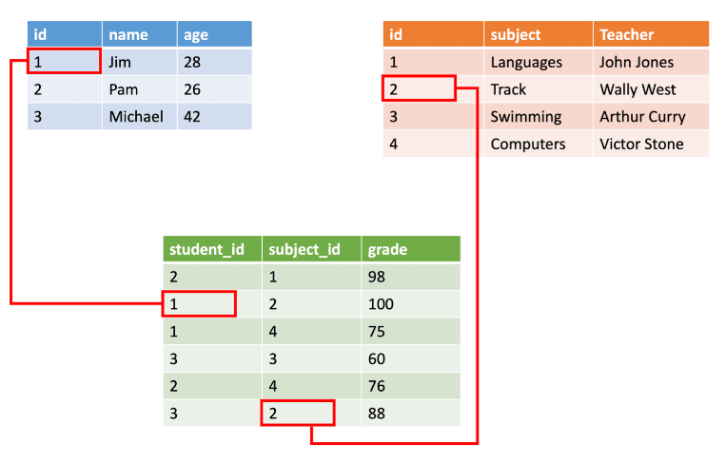
Structured data example
The mathematical term “relation” specifies a formed set of data held as a table.
In structured data, all row in a table has the same set of columns.

Slide 11
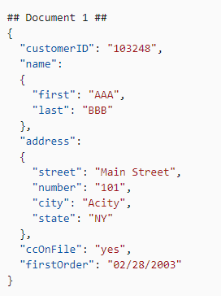
Semi-structured data
Semi-structured data is information that doesn’t consist of Structured data (relational database) but still has some structure to it.
In JavaScript Object Notation (JSON) format. It also includes key-value stores and graph databases.

Slide 12
Semi-Structured Data
Data exchange can benefit greatly from semi-structured data
  Exchange can be between applications, or between back-end and front-end of an application
  Web-services are widely used today, with complex data fetched to the front-end and displayed using a mobile app or JavaScript
JSON and XML are widely used semi-structured data models
Notes:
بسیاری از برنامه ها به ذخیره سازی داده های پیچیده نیاز دارند که طرح واره آنها اغلب تغییر می کند
نیاز مدل رابطه‌ای به انواع داده‌های اتمی ممکن است بیش از حد باشد
به عنوان مثال، ذخیره مجموعه ای از علایق به عنوان یک ویژگی با ارزش مجموعه ای از یک نمایه کاربر ممکن است ساده تر از نرمال سازی آن باشد.
the text suggests that this requirement might be excessive or unnecessary in some cases. For example, consider a user’s set of interests. It could be simpler and more efficient to store this as a single set-valued attribute in their profile rather than normalizing it into separate atomic values.
Normalization is the process of organizing data in a database to avoid duplication and inconsistency. But in this case, if we normalize the user’s interests, we would have to create a separate table to store each interest and then link it back to the user. This could complicate the database design and make queries more complex.
تبادل داده ها می تواند از داده های نیمه ساختاریافته سود زیادی ببرد
تبادل می‌تواند بین برنامه‌ها یا بین بک‌اند و جلوی یک برنامه باشد
وب سرویس ها امروزه به طور گسترده مورد استفاده قرار می گیرند، با داده های پیچیده که به قسمت جلو واکشی می شوند و با استفاده از یک برنامه تلفن همراه یا جاوا اسکریپت نمایش داده می شوند.
JSON و XML مدل های داده نیمه ساختار یافته پرکاربرد هستند
Some reasons why data exchange can benefit from semi-structured data:
Flexibility: Semi-structured data formats like JSON and XML are flexible, meaning they can represent complex hierarchical data structures, which can be very useful in data exchange.
Human Readable: These formats are text-based and human-readable, making it easier for developers to understand the data being exchanged.
Widely Supported: Most programming languages have built-in support for parsing and generating JSON and XML, making data exchange between different systems, even those implemented in different programming languages, relatively straightforward.
Schema Evolution: Semi-structured data can handle “schema-less” data or data where the schema can evolve over time. This is particularly useful in scenarios where the data structure changes frequently.

Slide 13
Features of Semi-Structured Data Models
Flexible schema
  Wide column representation: allow each tuple to have a different set of attributes, can add new attributes at any time
    user1 = {"username": "user1", "email": "user1@email.com", "bio": "Hello, world!", "website": "www.user1.com", "phone number": "+1234567890"}
    user2 = {"username": "user2", "email": "user2@email.com"}
  Sparse column representation: schema has a fixed but large set of attributes, by each tuple may store only a subset
    user1_preferences = {"likes_sports": True, "likes_cooking": False}
    user2_preferences = {"likes_travel": True}
Notes:
طرحواره انعطاف پذیر
نمایش ستون عریض: به هر تاپل اجازه می دهد مجموعه ای متفاوت از ویژگی ها را داشته باشد، می تواند در هر زمان ویژگی های جدید اضافه کند
نمایش ستون پراکنده: طرحواره دارای مجموعه ای ثابت اما بزرگ از ویژگی ها است، هر چند تاپل ممکن است فقط یک زیر مجموعه را ذخیره کند.
Wide Column Representation (Flexible Schema): In Instagram, each user (tuple) can have a different set of attributes.
For example, one user might have attributes like username, email, bio, website, and phone number, while another user might only have username and email. If Instagram decides to add a new feature like story highlights, they can easily add this new attribute to the user schema, and it will only appear for users who use this feature.
Sparse Column Representation: Consider a feature like user preferences that has a large but fixed set of attributes (like likes_sports, likes_cooking, likes_travel, etc.). Each user may only fill a subset of these preferences.
In this case, the schema for user preferences is sparse because not all attributes are used by each tuple (user).

Slide 14
Features of Semi-Structured Data Models
Multivalued data types:allow attributes to contain non-atomic values.
  Sets, multisets
    E.g.,: User 1, set of interests {‘Sport, ‘Cooking’, ‘Travel’, ‘anime’, ‘jazz’}
UserID | UserName | Email
1 | User1 | user1@email.com
2 | User2 | user2@email.com
InterestID | Interest
1 | Sports
2 | Cooking
3 | Travel
UserID | InterestID
1 | 1
1 | 3
Notes:
-Sets, Multisets: a set-valued attribute can be stored in a normalized form which provides no benefits in this case, since lookups are always based on the user, and normalization would significantly increase the storage and querying overhead.

Slide 15
(Cont.)Features of Semi-Structured Data Models
Multivalued data types:allow attributes to contain non-atomic values.
  Key-value map (or just map for short)
    Store a set of key-value pairs
    E.g., {(brand, Apple), (ID, MacBook Air), (size, 13), (color, silver)}
    Operations on maps: put(key, value), get(key), delete(key)
  In a relational database, you need to have a table for each of which due to normalization
    e-commerce sites often list specifications or details for each product that they sell, such as brand, model, size, color, and numerous other product-specific details.
    specifications form the key, and the associated value is stored with the key.
Notes:
Example: a social media application where users can post status updates. Each status update might have different data associated with it, such as text, images, location, tagged friends, reactions, and comments.
EXAMPLE: an example of a social media application where users can post status updates. Each status update might have different data associated with it, such as text, images, location, tagged friends, reactions, and comments.
In a relational database, you would typically normalize this data across several tables (e.g., Users, Posts, Images, Locations, Tags, Reactions, Comments). To retrieve a single status update and all its associated data, you would need to perform a complex query with multiple joins, which can be computationally expensive and slow.
On the other hand, in a semi-structured data model using a key-value store like MongoDB, each status update and all its associated data can be stored as a single document. The key would be the post_id, and the value would be a JSON object containing all the post data.

Slide 16
(Cont.)Features of Semi-Structured Data Models
Key-value map: Example: a social media application where users can post status updates
RELATIONAL DATABASE: SELECT * FROM Posts LEFT JOIN Images ON Posts.post_id = Images.post_id LEFT JOIN Locations ON Posts.post_id = Locations.post_id LEFT JOIN Tags ON Posts.post_id = Tags.post_id LEFT JOIN Reactions ON Posts.post_id = Reactions.post_id LEFT JOIN Comments ON Posts.post_id = Comments.post_id WHERE Posts.post_id = 123;
JSON:{ "post_id": 123, "text": "Hello, world!", "images": ["img1.jpg", "img2.jpg"], "location": "Paris, France", "tags": ["friend1", "friend2"], "reactions": {"likes": 100, "loves": 50, "wows": 10}, "comments": [ {"user": "friend1", "text": "Great post!", "time": "2022-01-01T10:00:00Z"}, {"user": "friend2", "text": "Thanks for sharing!", "time": "2022-01-01T11:00:00Z"} ] }
Notes:
-A key-value map, Example:
e-commerce sites often list specifications or details for each product that they sell, such as brand, model, size, color, and numerous other product-specific details.
the specifications form the key, and the associated value is stored with the key.
Example: a social media application where users can post status updates. Each status update might have different data associated with it, such as text, images, location, tagged friends, reactions, and comments.
In a relational database, you would typically normalize this data across several tables (e.g., Users, Posts, Images, Locations, Tags, Reactions, Comments).

Slide 17
(Cont.) Features of Semi-Structured Data Models
Arrays
  Widely used for scientific and monitoring applications
  E.g., readings taken at regular intervals can be represented as array of values instead of (time, value) pairs
    [5, 8, 9, 11] instead of {(1,5), (2, 8), (3, 9), (4, 11)}
    scientific applications may need to store images, which are two-dimensional arrays of pixel values
Multi-valued attribute types
  Modeled using non first-normal-form (NFNF) data model
  Supported by most database systems today: Oracle, PostgreSQL
Array database: a database that provides specialized support for arrays
  E.g., compressed storage, query language extensions etc
  Oracle GeoRaster, PostGIS extension to PostgreSQL, the SciQL extension of MonetDB, and SciDB
Notes:
پشتیبانی از انواع ویژگی‌های چند ارزشی در اوایل تاریخ پایگاه‌های داده پیشنهاد شد و مدل داده‌های مرتبط با فرم غیر عادی یا NFNF نامیده شد.
The Non-First Normal Form (NFNF) or Non-1NF is a data model that does not meet the conditions of the First Normal Form (1NF) defined by the relational model
Scientific experiments and industrial monitoring applications often use multiple sensors that provide readings at regular intervals. Such readings can be viewed as an array. In fact, treating a stream of readings as an array requires far less space than storing each reading as a separate tuple

Slide 18
Nested Data Types
Hierarchical data is common in many applications
  Many databases support such types as part of their support for object-oriented data
JSON: (JavaScript Object Notation)
  Widely used today
XML: (Extensible Markup Language)
  Earlier generation notation, still used extensively
Notes:
به طور مستقیم ویژگی‌های ترکیبی را در مدل E-R مدل‌سازی کنند. به عنوان مثال، یک نام ویژگی ممکن است دارای ویژگی های جزء firstname و lastname باشد.
JSON: (نشانگذاری شی جاوا اسکریپت) امروزه به طور گسترده استفاده می شود
XML: (زبان نشانه گذاری توسعه پذیر) نمادهای نسل قبلی، هنوز به طور گسترده استفاده می شود
Slide 1: JSON and XML - Overview
JSON and XML are both widely used for data exchange and storage.
JSON is commonly used in modern applications, while XML is an older format.
Slide 2: JSON - Usage
JSON is used for exchanging data between backends and user-facing sides of applications.
Commonly used in mobile apps and web apps.
XML is used by many systems for storing configuration and other information.
Also used for data exchange.
Slide 3: JSON - Advantages
JSON is favored for storing complex objects in storage systems.
Allows collection of different data related to a user into one large object (document).
Enables data retrieval without the need for joins.

Slide 19
JSON
Textual representation widely used for data exchange & store complex data
Example of JSON data
{
"ID": "22222",
"name": {
"firstname: "Albert",
"lastname: "Einstein"
},
"deptname": "Physics",
"children": [
{"firstname": "Hans", "lastname": "Einstein" },
{"firstname": "Eduard", "lastname": "Einstein" }
]
}
Types: integer, real, string, and
  Objects: are key-value maps, i.e. sets of (attribute name, value) pairs
  Arrays are also key-value maps (from offset to value)
Notes:
JSON is today the primary data representation used for communication between applications and web services.
Applications invoke web services by sending parameters either as simple values such as strings or numbers, or by using JSON for more complex parameters. The web service then returns results using JSON. F

Slide 20
JSON
JSON is ubiquitous in data exchange today
  Widely used for web services
  Most modern applications are architected around on web services
SQL extensions for
  JSON types for storing JSON data
  Extracting data from JSON objects using path expressions
    E.g. V-> ID, or v.ID
  Generating JSON from relational data
    E.g. json.build_object(‘ID’, 12345, ‘name’, ‘Einstein’)
  Creation of JSON collections using aggregation
    E.g. json_agg aggregate function in PostgreSQL
  Syntax varies greatly across databases
Notes:
Unlike a relational representation, JSON is verbose and takes up more storage space for the same data. Further, parsing the text to retrieve required fields can be very CPU intensive.
There are SQL extensions that allow construction of JSON objects in each row of a query result. For example, PostgreSQL supports a json build object() function. As an example of its use, json build object('ID', 12345, 'name' 'Einstein') returns a JSON object {"ID": 12345, "name", "Einstein"}.
Verbose پرمخاطب

Slide 21
XML
XML uses tags to mark up text
E.g.
<course>
<course id> CS-101 </course id>
<title> Intro. to Computer Science </title>
<dept name> Comp. Sci. </dept name>
<credits> 4 </credits>
</course>
Tags make the data self-documenting
Tags can be hierarchical
Notes:
XML از برچسب ها برای علامت گذاری متن استفاده می کند
چنین برچسب‌هایی می‌توانند برای نمایش داده‌های رابطه‌ای که نام‌های روابط را مشخص می‌کنند و در نام‌های ادای احترام به عنوان برچسب، همانطور که نشان داده شده است استفاده شود.

Slide 22
Example of Data in XML
<purchase order>
<identifier> P-101 </identifier>
<purchaser>
<name> Cray Z. Coyote </name>
<address> Route 66, Mesa Flats, Arizona 86047, USA </address>
</purchaser>
<supplier>
<name> Acme Supplies </name>
<address> 1 Broadway, New York, NY, USA </address>
</supplier>
<itemlist>
<item>
<identifier> RS1 </identifier>
<description> Atom powered rocket sled </description>
<quantity> 2 </quantity>
<price> 199.95 </price>
</item>
<item>…</item>
</itemlist>
<total cost> 429.85 </total cost>
….
</purchase order>

Slide 23
XML Cont.
XQuery language developed to query nested XML structures
  Not widely used currently
SQL extensions to support XML
  Store XML data
  Generate XML data from relational data
  Extract data from XML data types
    Path expressions
See Chapter 30 (online) for more information

Slide 24
Knowledge Representation
RDF: Resource Description Format
  is a standard way to make statements about resources. An RDF statement consists of three components, referred to as a triple:
  Subject is a resource being described by the triple.
  Predicate describes the relationship between the subject and the object.
  Object is a resource that is related to the subject.
Notes:
رابطه بین دانش گراف و مدل‌های زبانی بزرگ به شکلی دوجانبه است؛ از یک سو دانش گراف‌ها می‌توانند به عنوان منابع ساختاریافته و قابل تفسیر به LLM کمک کنند و از سوی دیگر، LLM می‌توانند در استخراج و سازماندهی دانش از داده‌های غیرساختاریافته به کار گرفته شوند.
اگرچه دانش گراف به خودی خود یک پایگاه داده محسوب نمی‌شود، اما برای ذخیره و مدیریت آن از پایگاه‌های داده گرافی مانند Neo4j، Amazon Neptune، OrientDB و نیز پایگاه‌های داده RDF مانند Apache Jena و Virtuoso استفاده می‌شود.
این تعاملات می‌تواند زمینه‌ساز نوآوری‌های چشمگیری در حوزه‌های هوش مصنوعی، پردازش زبان طبیعی و سیستم‌های دانش‌بنیان باشد.

Slide 25
Knowledge Representation
RDF: Resource Description Format
RDF is a data representation standard based on the entity-relationship mode: Subject(Entity), Predicate(Attribute), Object(Value)
    (ID, attribute-name, value)
    (ID1, relationship-name, ID2)
    where ID, ID1 and ID2 are identifiers of entities; entities are also referred to as resources in RDF
    Unlike, the E-R model, the RDF model only supports binary relationships, and it does not support more general n-ary relationships;
    Each triple has a unique identifier which is International Resource Identifier (IRI)
Notes:
Reference: (580) CS520: 2021 Knowledge Graphs Seminar Session 1 – YouTube
(نهاد یا فاعل ، مسند، مفعول)
Subject, predicate, object
مسند: صفت یا حالتی می باشد که آن را به نهاد نسبت می دهیم.برای به دست آوردن مسند ما باید سه کلمه پرسشی چه طور، چگونه و چه جور را از فعل جمله سوال بکنیم.
مثال: چشمه هاشان جوشان تا گاوهاشان شیرافشان باد.
برای اینکه در مثال بالا مسند را پیدا کنیم با توجه به اینکه فعل باد را به عنوان فعل اسنادی قبول کردیم با استفاده از یکی از کلمه پرسشی های ذکر شده می پرسیم:چه جور باد؟ شیر افشان
-نهاد انجام دهنده کار است. چه چیزی و یا چه کسی
مثال: قرآن معجزه ی بی نظير پيامبر گرامى اسلام است.
در مثال بالا است فعل اسنادى مى باشد.در مثال بالا معجزه ی بى نظير پيامبر گرامى اسلام مسند می شود.حالا برای به دست آوردن نهاد، جمله پرسشی زیر را می پرسیم:چه چیزی معجزه ی بی نظير پیامبر اسلام است؟ قرآن
مفعول را با (را) می‌شناسیم. مثلا : پرسش شما مفعول خواهد بود .
الف ) پرویز لباسش را پوشد . چه چیزی را پوشید؟ لباسش را
انواع پایگاه‌ داده‌‌های گرافی
برخی از معروف‌ترین پایگاه‌داده‌های گرافی که غالبا متن‌باز هستند عبارتند از
Grakn
FlockDB
AllegroGraph
GraphDB
InfiniteGraph
Neo4j

Slide 26
Knowledge Representation-Applications
Search Engines and Information Retrieval
Recommendation Systems
Healthcare and Life Sciences
Fraud Detection and Financial Services
Cybersecurity and Threat Intelligence
Supply Chain and Logistics Management
Enterprise Knowledge Management
Academic and Research Applications
Notes:
موتورهای جستجو و بازیابی اطلاعات
مثال: دانش گراف گوگل نتایج جستجو را با اتصال موجودیت‌ها (افراد، مکان‌ها، مفاهیم) به داده‌های زمینه‌ای غنی بهبود می‌بخشد. این امر موجب ارائه پاسخ‌های دقیق‌تر و مرتبط‌تر به پرس‌وجوها می‌شود و با کاهش ابهامات در پرس‌وجوهای جستجو، تجربه کاربری را ارتقا می‌دهد.
سیستم‌های توصیه‌گر
مثال: پلتفرم‌های تجارت الکترونیک مانند آمازون و ارائه‌دهندگان محتوا مانند نتفلیکس از دانش گراف‌ها برای مدل‌سازی روابط بین کاربران، محصولات و ترجیحات استفاده می‌کنند. با درک این اتصالات پیچیده، سیستم‌ها می‌توانند توصیه‌های شخصی‌سازی شده‌ای ارائه دهند که هم علایق آشکار و هم ضمنی کاربران را مد نظر قرار می‌دهد.
بهداشت و علوم زیستی
مثال: در کشف دارو و پشتیبانی از تصمیم‌گیری بالینی، دانش گراف‌ها داده‌های متنوع زیست‌پزشکی—از تعاملات ژنی تا نتایج آزمایش‌های بالینی—را یکپارچه می‌کنند. این دیدگاه جامع، شناسایی اهداف دارویی پتانسیل را تسهیل کرده و با افشای روابط پنهان بین علائم، درمان‌ها و نتایج، دقت تشخیصی را بهبود می‌بخشد.
شناسایی تقلب و خدمات مالی
مثال: مؤسسات مالی از دانش گراف‌ها برای نقشه‌برداری شبکه‌های پیچیده تراکنش‌ها و تعاملات مشتریان استفاده می‌کنند. با تجسم روابط بین حساب‌ها و تراکنش‌ها، ناهنجاری‌هایی که نشان‌دهنده فعالیت‌های تقلبی هستند به طور قابل اعتمادتری شناسایی می‌شوند. این رویکرد مبتنی بر داده‌های متصل، از استراتژی‌های ضد پولشویی (AML) نیز پشتیبانی می‌کند.
امنیت سایبری و اطلاعات تهدید
مثال: پلتفرم‌های امنیت سایبری از دانش گراف‌ها بهره می‌برند تا داده‌های تهدید، آسیب‌پذیری‌ها و الگوهای حمله را به یکدیگر مرتبط کنند. نمایش متصل شاخص‌های افشای نقض (IOC) و رفتارهای شبکه به شناسایی سریع و کاهش تهدیدات امنیتی نوظهور کمک می‌کند.
مدیریت زنجیره تأمین و لجستیک
مثال: شرکت‌های فعال در حوزه تولید و خرده‌فروشی از دانش گراف‌ها برای نظارت و بهینه‌سازی عملیات زنجیره تأمین استفاده می‌کنند. با مدل‌سازی روابط بین تأمین‌کنندگان، فرآیندهای تولید و کانال‌های توزیع، سازمان‌ها می‌توانند کارایی را افزایش داده، اختلالات را پیش‌بینی کنند و مقاومت کلی عملیاتی را تقویت نمایند.
مدیریت دانش سازمانی
مثال: در سازمان‌های بزرگ، دانش گراف‌ها به عنوان ستون فقرات یکپارچه‌سازی داده‌ها و پشتیبانی از تصمیم‌گیری عمل می‌کنند. با اتصال اسناد داخلی، داده‌های پروژه و دیدگاه‌های کارشناسی، سازمان‌ها می‌توانند همکاری بهتری ایجاد کرده، فرآیند بازیابی اطلاعات را بهینه کنند و از فرایندهای تصمیم‌گیری استراتژیک پشتیبانی نمایند.
کاربردهای آکادمیک و پژوهشی
مثال: مؤسسات آکادمیک و پلتفرم‌های پژوهشی، مانند Microsoft Academic Graph، از دانش گراف‌ها برای ارتباط دادن انتشارات، نویسندگان و موضوعات پژوهشی استفاده می‌کنند. این ساختار داده‌های متصل نه تنها از مرور ادبیات و فراتحلیل پشتیبانی می‌کند، بلکه با کشف روابط پنهان بین حوزه‌های پژوهشی، همکاری‌های بین‌رشته‌ای را ترویج می‌دهد.
Search Engines and Information Retrieval
Example: Google’s Knowledge Graph enhances search results by connecting entities (people, places, concepts) with rich contextual data. This allows for more precise and relevant query responses, improving user experience by reducing ambiguity in search queries.
Recommendation Systems
Example: E-commerce platforms like Amazon and content providers like Netflix utilize knowledge graphs to model relationships between users, products, and preferences. By understanding these complex interconnections, the systems can generate personalized recommendations that consider both explicit and implicit user interests.
Healthcare and Life Sciences
Example: In drug discovery and clinical decision support, knowledge graphs integrate diverse biomedical data—from gene interactions to clinical trial results. This holistic view facilitates the identification of potential drug targets and improves diagnostic accuracy by revealing previously hidden relationships between symptoms, treatments, and outcomes.
Fraud Detection and Financial Services
Example: Financial institutions apply knowledge graphs to map complex transaction networks and customer interactions. By visualizing relationships across accounts and transactions, anomalies that suggest fraudulent activity can be detected more reliably. This interconnected data approach also supports anti-money laundering (AML) strategies.
Cybersecurity and Threat Intelligence
Example: Cybersecurity platforms leverage knowledge graphs to correlate threat data, vulnerabilities, and attack patterns. The interconnected representation of indicators of compromise (IOCs) and network behaviors aids in the rapid identification and mitigation of emerging security threats.
Supply Chain and Logistics Management
Example: Companies in manufacturing and retail use knowledge graphs to monitor and optimize supply chain operations. By modeling relationships between suppliers, production processes, and distribution channels, organizations can improve efficiency, predict disruptions, and enhance overall operational resilience.
Enterprise Knowledge Management
Example: Within large organizations, knowledge graphs serve as the backbone for data integration and decision support. By linking internal documents, project data, and expert insights, enterprises can foster better collaboration, streamline information retrieval, and support strategic decision-making processes.
Academic and Research Applications
Example: Academic institutions and research platforms, such as Microsoft Academic Graph, use knowledge graphs to connect publications, authors, and research topics. This interconnected data structure not only supports literature review and meta-analysis but also promotes interdisciplinary collaborations by uncovering hidden relationships among research areas.

Slide 27
An example of a triple
Subject | Predicate | Object
Alireza | hasSpouse | Fatima
Alireza | hasAge | 25

Slide 28
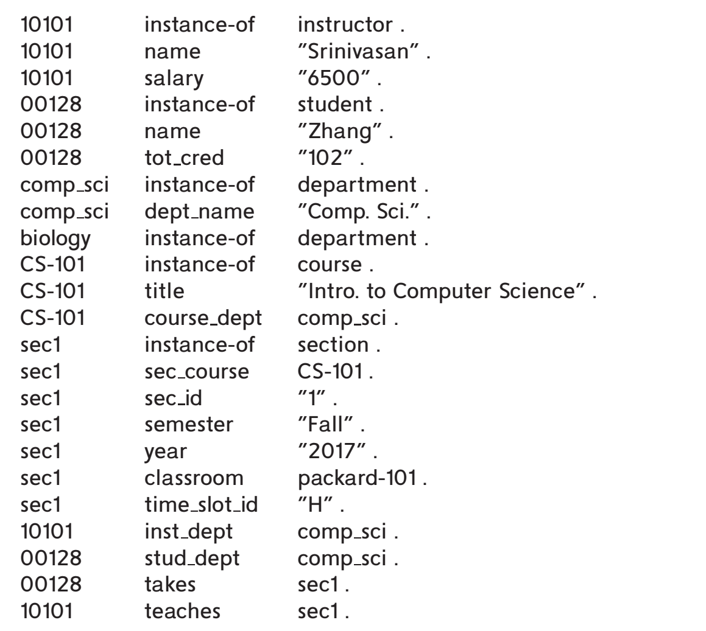
Triple View of RDF Data
a small part of the University database
Notes:
1. (ID, attribute-name, value) 2. (ID1, relationship-name, ID2)
Figure 8.3 shows a triple representation of a small part of the University database. All attribute values are shown in quotes, while identifiers are shown without quotes. Attribute and relationship names (which form the predicate part of each triple) are also shown without quotes.
--entity type information is represented using instance-of relationships between entities and objects representing types; type-subtype relationships can also be represented as subtype edges between type objects.
One such application is to store facts that are harvested from a variety of data sources, such as Wikipedia, Wikidata, and other sources on the web. An example of a fact is “Washington, D.C. is the capital of U.S.A.” Such a fact can be represented as an edge labeled capital-of connecting two nodes, one representing the entity Washington, D.C., and the other representing the entity U.S.A
The type information of objects is provided by the instance-of relationship; for example, 10101 is identified as an instance of instructor, while 00128 is an instance of student.
In contrast to the E-R model and relational schemas, RDF allows new attributes to be easily added to an object and also to create new types of relationships

Slide 29
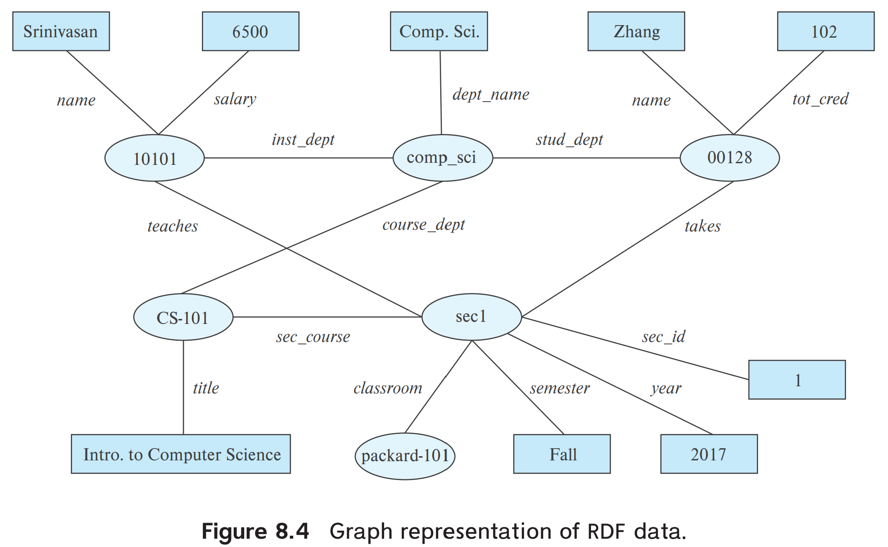
Graph View of RDF Data
Knowledge graph
Notes:
-Objects are shown as ovals, attribute values in rectangles, and relationships as edge with associated label identifying the relationship.
-We have omitted the instance-of relationships for brevity.
-Relationships shown in the figure include the takes and teaches relationships, which appear in the university schema.
-The departments of instructors, students and courses are shown as relationships inst dept, stud dept and course dept respectively
The first attribute of a triple is called its subject, the second attribute is called its predicate, and the last attribute is called its object.
صفت اول ثلاث را فاعل و صفت دوم را گزاره (مورد تاکید) و صفت آخر را مفعول می نامند.
, a triple has the structure (subject, predicate, object).

Slide 30
Knowledge Representation
Representation of human knowledge is a long-standing goal of AI
A representation of information using the RDF graph model (or its variants and extensions) is referred to as a knowledge graph.
Knowledge graphs are used for a variety of purposes. One such application is to store facts that are harvested from a variety of data sources, such as Wikipedia, Wikidata, and other sources on the web.
RDF: Resource Description Format
  Simplified representation for facts, represented as triples
  (subject, predicate, object)
    E.g., (NBA-2019, winner, Raptors)
    (Washington-DC, capital-of, USA)
    (Washington-DC, population, 6,200,000)
Notes:
Questions about entities can be answered using a knowledge graph that contains relevant information.
For example, the question “Which city is the capital of the U.S.A.?” can be answered by looking for an edge labeled capital-of, linking an entity to the country U.S.A. (If type information is available, the query may also verify that there is an instance-of edge connecting Washington, D.C., to a node representing the entity type City).

Slide 31
Knowledge graph
·Resurgence of interest in Knowledge Graphs·
  Search engines
  Data integration
  Artificial Intelligence
(580) CS520: 2021 Knowledge Graphs Seminar Session 1 - YouTube
Notes:
· تجدید علاقه به نمودارهای دانش
موتورهای جستجو.
یکپارچه سازی داده ها
هوش مصنوعی

Slide 33
Data Integration
For example Data reside in multiple sources·
  Company directory, product catalog, government database, weather report,
Answering queries requires combining data from multiple sources.
  We need to provide translations of data between multiple sources·
    Direct mappings
    Shared schema
Notes:
Data reside in multiple sources: Let’s say a multinational corporation has offices in different countries. Each office maintains its own employee directory, product catalog, and sales data. These are separate data sources that may be stored in different formats and databases.
Direct mappings: This is a type of data integration where data from one source is directly mapped to another. For example, if two databases have a similar structure, the ‘EmployeeID’ field in one database could be directly mapped to the ‘EmpID’ field in another database.
Shared schema: This is a more complex form of data integration where multiple data sources conform to an agreed-upon schema. For example, all offices in the corporation could agree to use the same names and formats for their fields, such as ‘EmployeeID’, ‘FirstName’, ‘LastName’, and ‘SalesAmount’. This shared schema allows data from different sources to be easily combined and analyzed.

Slide 34
Data Integration
Schema-free approach to data integration.
  Convert the relational data from multiple sources into triples·
    Stored in a graph database·
      Referred to as a knowledge graph.
    Deal with schema mappings/translations on "pay as you go" basis·
      Visualization
      Optimized for graph traversals
Notes:
First you convert the relational data from sources into triples, you can call it a knowledge graph but it is just a simple convert.
The real problem comes when you need specific data, so have to find out new relationships from these triples. So you have to translate new relationships which is called pay-as-you-go.
Converting relational data into triples: This is the first step in creating a knowledge graph. In this step, data from various sources (like databases, spreadsheets, etc.) is converted into a standardized format known as triples. Each triple consists of a subject, predicate, and object, which together express a fact. For example, if we have relational data about a person named John who lives in Berlin, this could be converted into a triple like (“John”, “lives in”, “Berlin”).
Finding new relationships: Once the data is in the form of triples, we can start to discover new relationships between different pieces of data. This is where the real power of knowledge graphs comes in. For example, if we have another triple that says (“Berlin”, “is in”, “Germany”), we can infer a new relationship: (“John”, “lives in”, “Germany”).
Pay-as-you-go: This term refers to the idea of incrementally building and refining the knowledge graph as new data comes in or as new relationships are discovered. Instead of trying to perfectly map and integrate all data upfront, we can start with a simple conversion (as you mentioned), and then gradually improve the graph over time by adding new triples and relationships as they are needed.

Slide 35
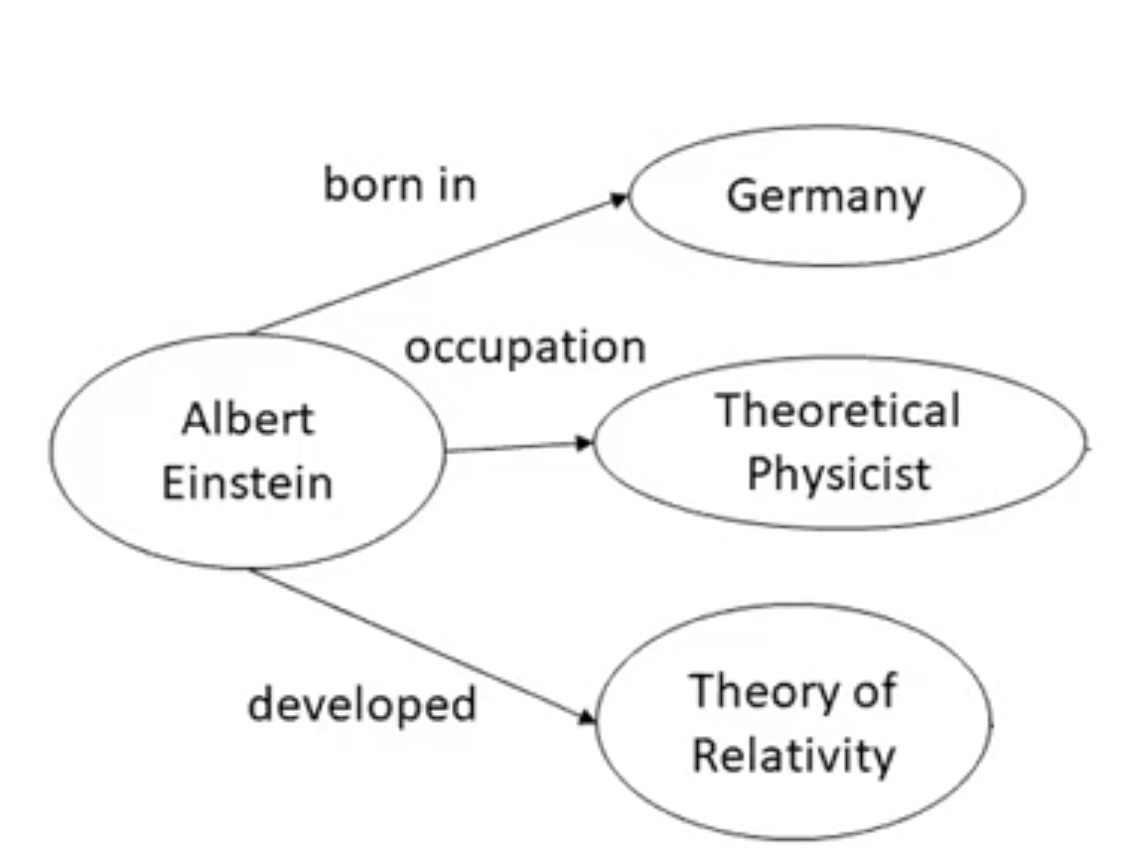
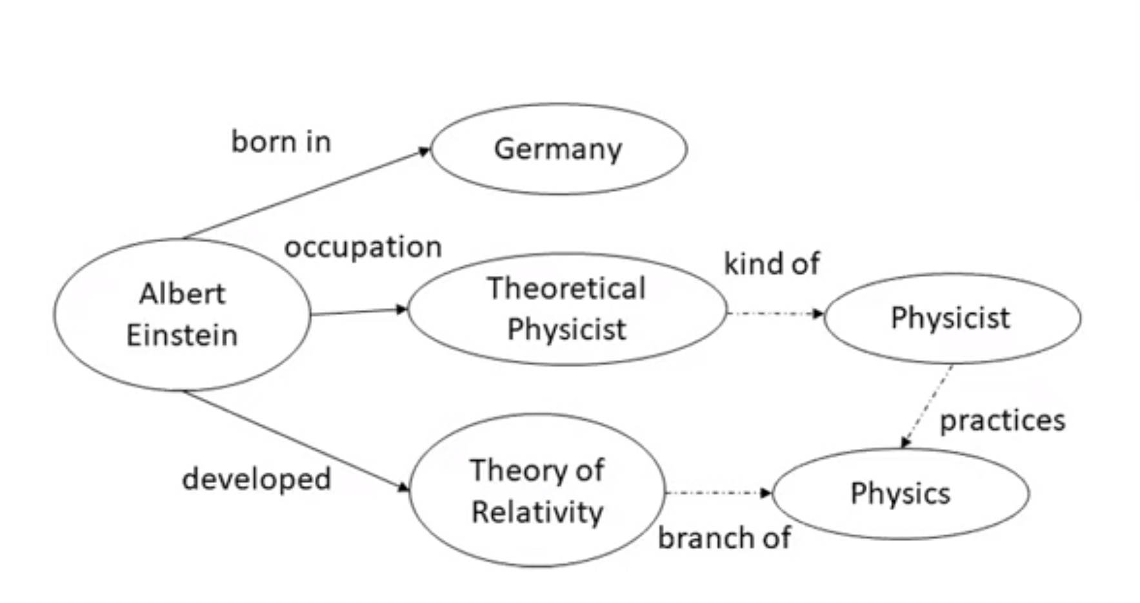
Knowledge graph: Natural Language Processing
Entity Extraction:
  Albert Einstein was a German-born theoretical physicist who developed the theory of relativity.
  Relation Extraction->
  New relations
    Questions answering
    Common reasoning

Slide 36
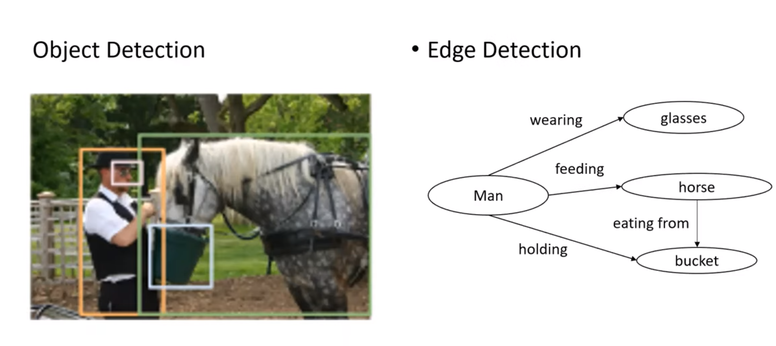
Knowledge graph in Object detection
Notes:
Input to Machine Learning.
Machine learning requires numerical input.
Symbolic inputs must be converted to numerical input·
A process known as embedding· Word Embeddings· Graph Embeddings

Slide 37
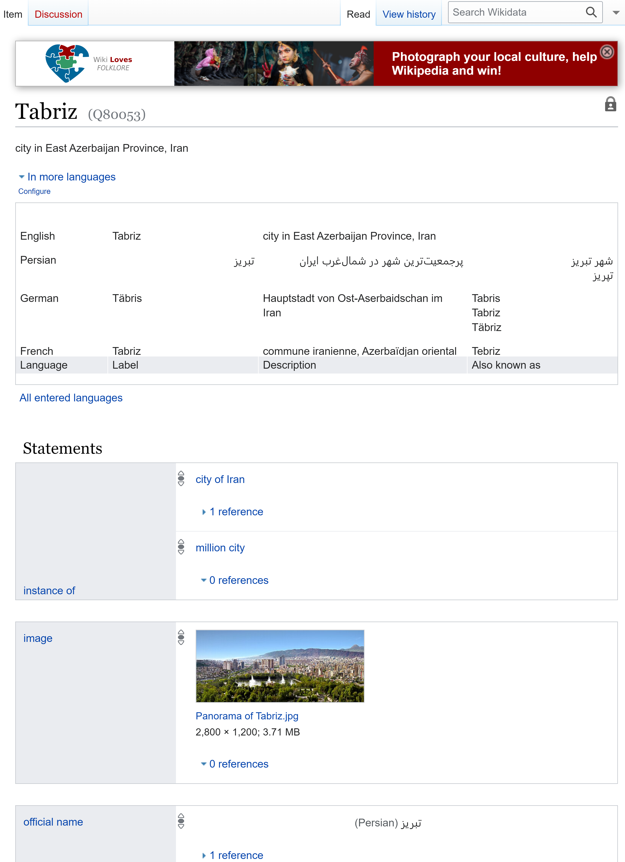
WIKIDATA.ORG-> KNOWLEDGE GRAPH
https://www.wikidata.org/wiki/Q80053
Notes:
FOR a search engine, You are looking for information about Tabriz. If you use a relational database, you need to query all the information about Tabriz from all the tables, but you don’t know how many table do you need. Plus, the information about Tabriz increases during the time, So how do you know how many tables are going to be needed before hand.

Slide 38
Querying RDF: SPARQL
SPARQL is a query language designed to query RDF data.
  is based on triple patterns, which look like RDF triples but may contain variables. For example,
Triple patterns
  ?cid title "Intro. to Computer Science"
    match all triples whose predicate is “title” and object is “Intro. to Computer Science”
Notes:
Subject(Entity), Predicate(Attribute), Object(Value)
?: question mark
“: double quotation

Slide 39
What is SPARQL?
SPARQL is a SQL-like query language for RDF graph data with the following query types:
SELECT returns tabular results
CONSTRUCT creates a new RDF graph based on query results
ASK returns ‘yes’ if the query has a solution, otherwise ‘no’
DESCRIBE returns RDF graph data about a resource; useful when the query client does not know the structure of the RDF data in the data source
INSERT inserts triples into a graph
DELETE deletes triples from a graph

Slide 40
University Database

Slide 41
Querying RDF: SPARQL
Another Example of SPARQL:
  ?cid title "Intro. to Computer Science"
  ?sid sec_course ?cid
    On the university-triple dataset, the first triple pattern matches the triple:
      (CS-101, title, "Intro. to Computer Science"),
    the second triple pattern matches
      (sec1, course, CS-101).
    The shared variable ?cid enforces a join condition between the two triple patterns.
Notes:
با تمام ثلاث هایی که گزاره آنها "عنوان" و مفعول "مقدمه ای بر علوم کامپیوتر" است مطابقت دهید.
On the university-triple dataset shown in Figure 8.3, the first triple pattern matches the triple (CS-101, title, "Intro. to Computer Science"), while the second triple pattern matches (sec1, course, CS-101).
?cid title "Intro. to Computer Science“
?sid course ?cid
On the university-triple dataset shown in Figure 8.3, the first triple pattern matches the triple (CS-101, title, "Intro. to Computer Science"), while the second triple pattern matches (sec1, course, CS-101).
- SECOND query select, where: retrieves names of all students who have taken a section whose course is titled “Intro. to Computer Science”.

Slide 42
Graph View of RDF Data
Knowledge graph
Notes:
-Objects are shown as ovals, attribute values in rectangles, and relationships as edge with associated label identifying the relationship.
-We have omitted the instance-of relationships for brevity.
-Relationships shown in the figure include the takes and teaches relationships, which appear in the university schema.
-The departments of instructors, students and courses are shown as relationships inst dept, stud dept and course dept respectively
The first attribute of a triple is called its subject, the second attribute is called its predicate, and the last attribute is called its object.
صفت اول ثلاث را فاعل و صفت دوم را گزاره (مورد تاکید) و صفت آخر را مفعول می نامند.
, a triple has the structure (subject, predicate, object).

Slide 43
Querying RDF: SPARQL
SPARQL queries
  select ?name
  where {
  ?cid title "Intro. to Computer Science" .
  ?sid sec_course ?cid .
  ?id takes ?sid .
  ?name name ?id .
  }
  Also supports
    Aggregation, Optional joins (similar to outerjoins), Subqueries, etc.
    Transitive closure on paths
The following query retrieves names of all students who have taken a section whose course is titled “Intro. to Computer Science”.
Notes:
The following query retrieves names of all students who have taken a section whose course is titled “Intro. to Computer Science”.
The shared variables between these triples enforce a join condition between the tuples matching each of these triples

Slide 44


Graph View of RDF Data
Knowledge graph
Notes:
-Objects are shown as ovals, attribute values in rectangles, and relationships as edge with associated label identifying the relationship.
-We have omitted the instance-of relationships for brevity.
-Relationships shown in the figure include the takes and teaches relationships, which appear in the university schema.
-The departments of instructors, students and courses are shown as relationships inst dept, stud dept and course dept respectively
The first attribute of a triple is called its subject, the second attribute is called its predicate, and the last attribute is called its object.
صفت اول ثلاث را فاعل و صفت دوم را گزاره (مورد تاکید) و صفت آخر را مفعول می نامند.
, a triple has the structure (subject, predicate, object).

Slide 45
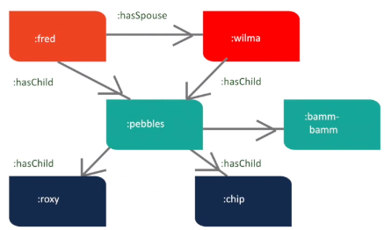
Using SPARQL to Insert Triples
To create an RDF graph, perform these steps:
  Define prefixes to IRIs with the PREFIX keywordo
  Use INSERT DATA to signify you want to insert statements. Write the subject-predicate-object statements (triples).
  Execute this query.
PREFIX br: http://bedrock/
INSERT DATA {
  :fred :hasSpouse :wilma .
  :fred :hasChild :pebbles .
  :wilma :hasChild :pebbles .
  :pebbles :hasSpouse :bamm-bamm ;
  :hasChild :roxy, :chip .
}
Notes:
An IRI (Internationalized Resource Identifier) within an RDF graph is a Unicode string [UNICODE] that conforms to the syntax defined in RFC 3987 [IRI]. IRIs are a generalization of URIs [URI].
Br is a shortcat to access <http://bedrock/>
For example “http://www.example.com/person_alice” and have information about each subject (here: Alice) accessible online at the same address. This is the idea at the foundation of the “Semantic Web”, a concept that focuses on creating a direct link between the data stored in databases and available on the internet. That being said, following these practices is not necessary for building effective, intelligent applications with graph databases
In SPARQL, the URIs used in prefixes do not necessarily need to exist. The purpose of prefixes is to provide a short and convenient label for longer URIs or IRIs.
Prefixes Are Abbreviations:
When you define a prefix, you associate it with a full IRI (Uniform Resource Identifier).
The prefix itself doesn’t represent an actual resource; it’s just a shorthand notation.
No Requirement for Existence:
The URIs used in prefixes don’t have to correspond to real resources on the web.
They can be placeholders or abstract identifiers.
For example, you can define a prefix like this:PREFIX ex: <http://example.org/resource/>
Use Meaningful Prefixes:
While the URIs don’t need to exist, it’s good practice to choose meaningful prefixes.
Prefixes like ex, rdf, dc, etc., are commonly used to represent common namespaces.
Actual Data Is in the Triples:
The actual data in your RDF graph resides in the triples (subject-predicate-object).
The prefixes are just a way to make your queries more concise.
Remember that SPARQL queries operate on the data stored in your RDF graph, regardless of whether the URIs in the prefixes exist as actual web resources. 🌟

Slide 46
Using SPARQL to Insert Triples. (Con.t)
In SPARQL, a prefix is a shorthand notation for a namespace URI (Uniform Resource Identifier). It simplifies writing and reading URIs in the query. For example:
PREFIX br: http://bedrock/
INSERT DATA {
:fred :hasSpouse :wilma .
:fred :hasChild :pebbles .
:wilma :hasChild :pebbles .
:pebbles :hasSpouse :bamm-bamm ;
:hasChild :roxy, :chip .
}
Notes:
An IRI (Internationalized Resource Identifier) within an RDF graph is a Unicode string [UNICODE] that conforms to the syntax defined in RFC 3987 [IRI]. IRIs are a generalization of URIs [URI].
Where is the URI Located?
Not on the Internet: The URI http://example.org/ doesn’t need to point to a real webpage. It’s just a string to uniquely identify resources.
Local Storage: The data you create (e.g., :fred, :wilma) exists in your RDF database or file, not on the internet.
PREFIX : <http://example.org/>
INSERT DATA {
:fred :hasSpouse :wilma .
:fred :hasChild :pebbles .
}
Translates to:
turtle
Copy
<http://example.org/fred> <http://example.org/hasSpouse> <http://example.org/wilma> . <http://example.org/fred> <http://example.org/hasChild> <http://example.org/pebbles> .
Br is a shortcat to access <http://bedrock/>
For example “http://www.example.com/person_alice” and have information about each subject (here: Alice) accessible online at the same address. This is the idea at the foundation of the “Semantic Web”, a concept that focuses on creating a direct link between the data stored in databases and available on the internet. That being said, following these practices is not necessary for building effective, intelligent applications with graph databases
In SPARQL, the URIs used in prefixes do not necessarily need to exist. The purpose of prefixes is to provide a short and convenient label for longer URIs or IRIs.
Prefixes Are Abbreviations:
When you define a prefix, you associate it with a full IRI (Uniform Resource Identifier).
The prefix itself doesn’t represent an actual resource; it’s just a shorthand notation.
No Requirement for Existence:
The URIs used in prefixes don’t have to correspond to real resources on the web.
They can be placeholders or abstract identifiers.
For example, you can define a prefix like this:PREFIX ex: <http://example.org/resource/>
Use Meaningful Prefixes:
While the URIs don’t need to exist, it’s good practice to choose meaningful prefixes.
Prefixes like ex, rdf, dc, etc., are commonly used to represent common namespaces.
Actual Data Is in the Triples:
The actual data in your RDF graph resides in the triples (subject-predicate-object).
The prefixes are just a way to make your queries more concise.
Remember that SPARQL queries operate on the data stored in your RDF graph, regardless of whether the URIs in the prefixes exist as actual web resources. 🌟

Slide 47
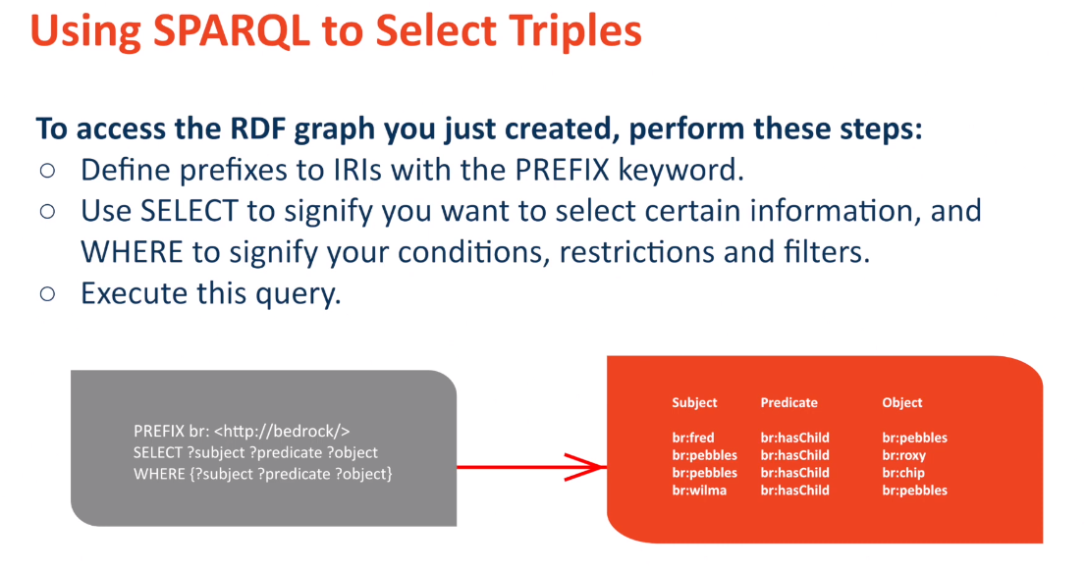

Slide 48
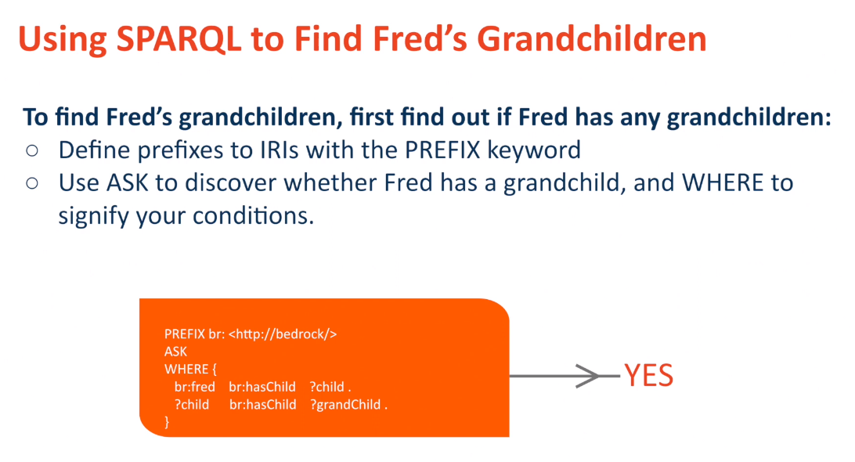
Notes:
If the answer is yes, we change the query

Slide 49
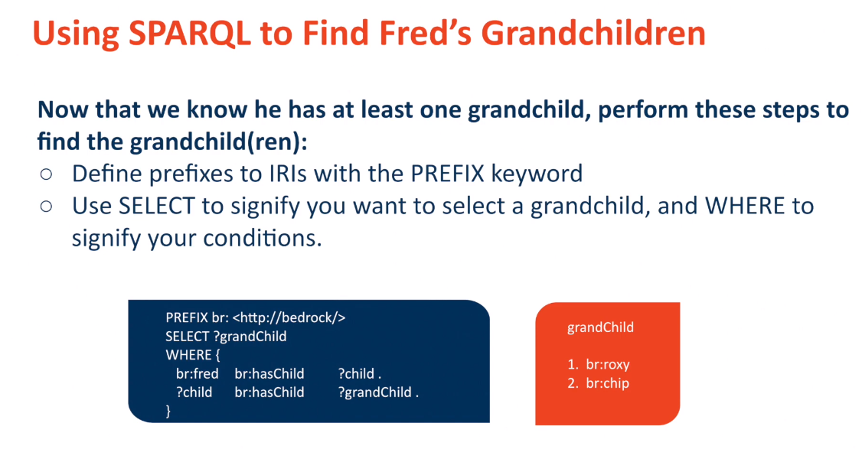

Slide 50
RDF Representation (Cont.)
RDF widely used as knowledge base representation
  DBPedia, Yago, Freebase, WikiData, ..
Linked open data project aims to connect different knowledge graphs to allow queries to span databases

Slide 51
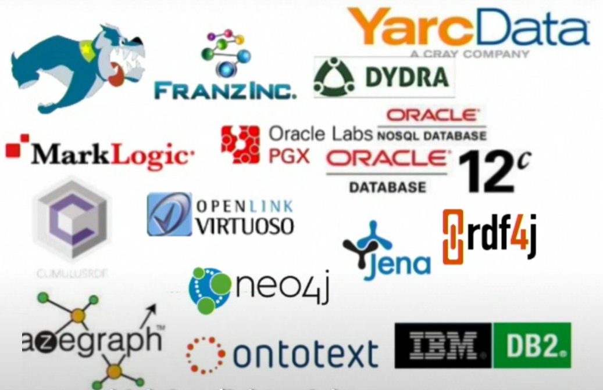
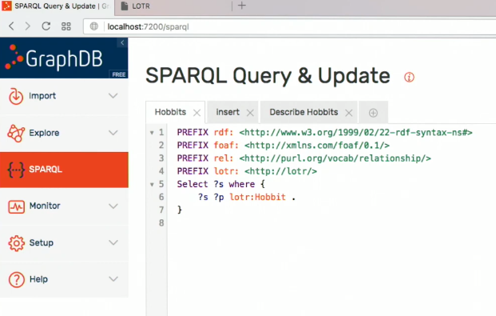
RDF DATA STORES:

Slide 52
Object Orientation
Object-relational data model provides richer type system
  with complex data types and object orientation
Applications are often written in object-oriented programming languages
  Type system does not match relational type system
  Switching between imperative language and SQL is troublesome
Notes:
imperative language زبان های امری

Slide 53
Object Orientation
Approaches for integrating object-orientation with databases
  Build an object-relational database, adding object-oriented features to a relational database
  Automatically convert data between programming language model and relational model; data conversion specified by object-relational mapping
  Build an object-oriented database that natively supports object-oriented data and direct access from programming language
Notes:
imperative language زبان های امری

Slide 54
Object-Oriented Programming and Databases
Point 1: Many database applications are written using an object-oriented programming language.
  Examples: Java, Python, C++
Point 2: These applications need to store and fetch data from databases.
Point 3: There is a type difference between the native type system of the object-oriented programming language and the relational model supported by databases.
Point 4: Data need to be translated between the two models whenever they are fetched or stored.
Notes:
Merely extending the type system supported by the database was not enough to solve this problem completely.
It is desirable, for many applications, to have programming language constructs or extensions that permit direct access to data in the database, without having to go through an intermediate language such as SQL

Slide 55
Object-Relational Database Systems
SQL allow creation of structured user-defined types:
  create type Person
  (ID varchar(20) primary key,
  name varchar(20),
  address varchar(20)) ref from(ID);
  create table people of Person;
Then we create a new person as follows:
  insert into people (ID, name, address) values ('12345', 'Srinivasan', '23 Coyote Run')
Notes:
Object extensions to SQL allow creation of structured user-defined types, references to such types, and tables containing tuples of such types.1
REF FROM(ID): This line is specifying that the ID attribute is used as the REF type. A REF type is a system-defined type that holds a reference to a row of a specified user-defined type. In this case, it’s saying that the ID attribute can be used to reference a Person.

Slide 56
Object-Relational Database Systems
Table user types
  create type interest as table (
  topic varchar(20),
  degree_of_interest int);
  SQL Server allows table-valued types(e.g., interest type) to be declared as shown in the following example:
  create table users (
  ID varchar(20),
  name varchar(20),
  interests interest);
Array, multiset data types also supported by many databases
Notes:
Many database systems support array and table types; attributes of relations and of user-defined types can be declared to be of such array or table types.
The support for such features as well as the syntax varies widely by database system. In PostgreSQL, for example, integer[] denotes an array of integers whose size is not prespecified, while Oracle supports the syntax varray(10) of integer to specify an array of 10 integers.
User-defined types can also have methods associated with them. Only a few database systems, such as Oracle, support this feature; we omit details.

Slide 57
Type and Table Inheritance
Type inheritance
  create type Person
  (ID varchar(20) primary key,
  name varchar(20),
  address varchar(20)) ref from(ID);
  We want to store extra information in the database about people who are students
  create type Student under Person
  (degree varchar(20)) ;
  create type Teacher under Person
  (salary integer);
  Both Student and Teacher inherit the attributes of Person
Notes:
Both Student and Teacher inherit the attributes of Person—namely, ID, name, and address. Student and Teacher are said to be subtypes of Person, and Person is a supertype of Student, as well as of Teacher

Slide 58
Type and Table Inheritance
Table inheritance syntax in PostgreSQL and oracle
  create table students
  (degree varchar(20))
  inherits people;
  create table teachers
  (salary integer)
  inherits people;
  create table people of Person;
  create table students of Student
  under people;
  create table teachers of Teacher
  under people;
As a result, every attribute present in the table people is also present in the subtables students and teachers.
Notes:
There are the example of how a table student from Student table which is inherited from Peaple.

Slide 59
Reference Types
For example, we could define the Person type as follows, with a reference-type declaration:
Creating reference types
  create type Person
  (ID varchar(20) primary key,
  name varchar(20),
  address varchar(20))
  ref from(ID);
  create table people of Person;
Notes:
Some SQL implementations such as Oracle support reference types.
By default, SQL assigns system-defined identifiers for tuples, but an existing primarykey value can be used to reference a tuple by including the ref from clause in the type definition as shown above.
Reference Types:
These are special data types that allow you to indirectly reference a row (tuple) within a table.
Instead of storing the actual data, they store a unique identifier that points to the specific row.
This can be beneficial for managing complex object relationships where direct data storage might be inefficient.
System-defined Identifiers:
By default, most SQL databases assign unique identifiers (typically hidden) to each row for internal management.
These identifiers are not directly accessible or usable by users for referencing purposes.

Slide 60
Reference Types
a type Department with a field name and a field head that is a reference to the type Person.
create type Department (
dept_name varchar(20),
head ref(Person) scope people);
create table departments of Department
scope clause above completes the definition of the foreign key from departments.head to the people relation.
insert into departments values ('CS', '12345’)
Notes:
a type Department with a field name and a field head that is a reference to the type Person.
scope clause above completes the definition of the foreign key from departments.head to the people relation

Slide 61
Object-Relational Mapping
Object-relational mapping (ORM) systems allow
  Specification of mapping between programming language objects and database tuples
  Automatic creation of database tuples upon creation of objects
  Automatic update/delete of database tuples when objects are update/deleted
  Interface to retrieve objects satisfying specified conditions
Details in Section 9.6.2
  Hibernate ORM for Java
  Django ORM for Python
Notes:
The primary goal of object-relational mapping systems is to ease the job of programmers who build applications by providing them an object model while retaining the benefits of using a robust relational database underneath.
As an added benefit, when operating on objects cached in memory, object-relational systems can provide significant performance gains over direct access to the underlying database.
When data objects are read from the database, they can be kept in the application’s memory for a while. This means that if the application needs to refer to the same data again, it can use the cached copy instead of making another expensive trip to the database. This can result in significant performance gains, especially for read-heavy applications or applications with complex transactional requirements
for applications with very complex database schemas or advanced database-specific features, writing SQL queries directly might be more efficient or flexible. As with any technology choice, it’s important to consider the specific needs and constraints of your project.

Slide 62
ORM benefits
Simplify the job of developers by providing an object model, while still leveraging the power of a robust relational database.
ORM systems can offer significant performance improvements when operating on objects cached in memory, compared to direct access to the underlying database.
ORM can use any number of databases to store data, all with the same high-level code.
ORM systems abstract away minor SQL differences between databases. This makes migration from one database to another relatively straightforward when using an ORM, as opposed to the significant challenges posed by SQL differences.
Notes:
Object-relational mapping systems can suffer from significant performance inefficiencies for bulk database updates, as well as for complex queries that are written directly in the imperative language. It is possible to update the database directly, bypassing the object-relational mapping system, and to write complex queries directly in SQL in cases where such inefficiencies are discovered

Slide 63
ORM EXAMPLE
Imagine you're building an online store. You need to manage data like products, customers, and orders.
Without ORM:
  You'd write complex SQL queries to interact with the database: add new products, update order details, etc.
  You'd need to understand the specific syntax for your chosen database (MySQL, PostgreSQL, etc.).
  Switching databases would require rewriting most or all of your SQL code, due to different syntax and functionalities.
With ORM:
  You'd define your data structures as objects (Product, Customer, Order).
  You'd use simple, object-oriented methods to interact with your data:
    product.save(), order.update_status().
  The ORM system translates these object operations into the appropriate SQL queries
  Switching databases might involve some configuration changes within the ORM, but most of your code would remain the same.
Notes:
Benefits:
Developer productivity: Easier and faster to write and maintain code.
Performance: Cached objects can be faster to access than direct database calls.
Database independence: Code is portable across different databases.
Reduced complexity: ORM abstracts away low-level details.
Note: Although ORMs offer advantages, they aren't perfect solutions for every scenario. Consider the complexity of your project and specific needs when choosing an approach.

Slide 64
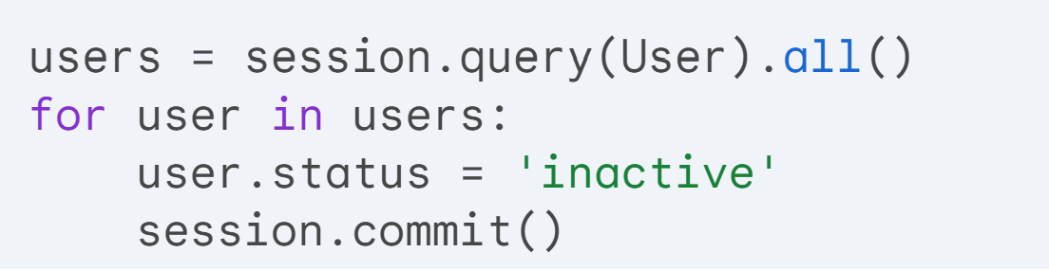
Performance issue of ORM
We have a User table in a database and we are using an ORM system in our application.
we want to update the status of all users to inactive.
  This result in a separate UPDATE statement for each user, which could be very inefficient if there are a large number of users.
Alternative where we bypass the ORM and write the update directly in SQL
  Executing a single UPDATE statement for all users is significantly more efficient than issuing individual statements for each user.
Notes:
users = session.query(User).all(): This line fetches all User objects from the database using the ORM's session object.
for user in users:: This loop iterates over each user object retrieved.
user.status = 'inactive': Inside the loop, the status attribute of each user object is directly modified to "inactive".
session.commit(): After modifying each user object, session.commit() is called to save the changes to the database. This results in a separate UPDATE statement for each user.
Inefficiency for large datasets: If there are a large number of users, this approach can be inefficient because it executes a separate SQL UPDATE statement for each user. This can lead to performance issues and unnecessary database load.
Explanation:
session.execute("UPDATE users SET status='inactive’”)
session.commit()
session.execute("UPDATE users SET status='inactive'"): This line bypasses the ORM and directly executes a single SQL UPDATE statement against the users table, setting the status of all users to "inactive".
session.commit(): Similar to the ORM approach, session.commit() is called to persist the changes to the database.
Advantage of this approach:
Efficiency for large datasets: Executing a single UPDATE statement for all users is significantly more efficient than issuing individual statements for each user, especially when dealing with large datasets

Slide 65
Textual Data
Information Retrieval Definition:
  Information retrieval is the process of querying unstructured textual data. Which is used in
  Traditional Model: Textual information is organized into documents.
  Database Context: A text-valued attribute can be considered a document.
  Web Context: Each web page can be considered a document.
Notes:
داده های متنی از متون بدون ساختار تشکیل شده اند.
اصطلاح بازیابی اطلاعات به طور کلی به جستجوی داده های متنی بدون ساختار اشاره دارد.
در مدل سنتی استفاده شده در حوزه بازیابی اطلاعات، اطلاعات متنی در قالب اسناد سازماندهی می شوند. در یک پایگاه داده، یک ویژگی با ارزش متنی را می توان یک سند در نظر گرفت. در متن وب، هر صفحه وب را می توان به عنوان یک سند در نظر گرفت.

Slide 66
Textual Data (Cont.)
Keyword Description: Desired documents are typically described by a set of keywords.
Examples: Keywords such as “database system” can locate documents on database systems. “Stock” and “scandal” can locate articles about stock-market scandals.
Document Keywords: Documents have a set of keywords associated with them. Typically, all words in the documents are considered keywords.
Keyword Query: A keyword query retrieves documents whose set of keywords contains all the keywords in the query.
Notes:
عنوان کلیدواژه: شرح
توضیحات: مجموعه ای از کلیدواژه ها به طور معمول برای توصیف اسناد مورد نظر استفاده می شوند. این کلیدواژه ها مفاهیم اصلی و موضوعات کلیدی موجود در سند را خلاصه می کنند.
مثال ها: کلیدواژه هایی مانند "سیستم پایگاه داده" می توانند اسنادی را در مورد سیستم های پایگاه داده پیدا کنند. "سهام" و "رسوایی" می توانند مقالاتی را در مورد رسوایی های بازار سهام پیدا کنند.
کلیدواژه های سند:
توضیحات: به هر سند مجموعه ای از کلیدواژه ها اختصاص داده شده است. به طور معمول، تمام کلمات موجود در سند به عنوان کلیدواژه در نظر گرفته می شوند. با این حال، در برخی موارد ممکن است از رویکردهای پیشرفته‌تری برای انتخاب کلیدواژه‌های مرتبط‌تر استفاده شود.
پرس و جوی کلیدواژه:
توضیحات: یک پرس و جوی کلیدواژه اسنادی را بازیابی می کند که مجموعه کلیدواژه های آنها حاوی همه کلیدواژه های موجود در پرس و جو باشد. به عبارت دیگر، برای اینکه سندی با پرس و جو مطابقت داشته باشد، باید تمامی کلیدواژه های پرس و جو در آن وجود داشته باشند.
نکات اضافی:
کلیدواژه ها، ابزاری قدرتمند برای سازماندهی، جستجو و بازیابی اطلاعات متنی هستند.
انتخاب کلیدواژه های مناسب برای اسناد و پرس و جوها، نتایج جستجوی دقیق و مرتبط را به همراه خواهد داشت.

Slide 67
Textual Data
Information retrieval: querying of unstructured data
  Simple model of keyword queries: given query keywords, retrieve documents containing all the keywords
  More advanced models rank relevance of documents
  Today, keyword queries return many types of information as answers
    E.g., a query “cricket” typically returns information about ongoing cricket matches like scores, league table
Relevance ranking
  Essential since there are usually many documents matching keywords
Notes:
بازیابی اطلاعات: جستجوی داده های بدون ساختار
توضیحات: بازیابی اطلاعات فرآیند بازیابی اطلاعات مورد نیاز از مجموعه ای از داده های بدون ساختار، مانند متن، تصاویر و صدا را گویند. این حوزه به توسعه تکنیک ها و الگوریتم هایی برای یافتن اطلاعات مرتبط با نیاز کاربر، بر اساس پرس و جوهای ارائه شده، می پردازد.
مدل ساده پرس و جوهای کلیدواژه ای:
توضیحات: در این مدل ساده، با وارد کردن کلیدواژه های مورد نظر به عنوان پرس و جو، اسنادی که حاوی تمام آن کلیدواژه ها هستند، بازیابی می شوند.
مثال: اگر کلیدواژه های پرس و جو "فوتبال" و "لیگ برتر" باشند، اسنادی که در مورد لیگ برتر فوتبال صحبت می کنند، بازیابی خواهند شد.
مدل های پیشرفته تر: رتبه بندی ارتباط Relevance Ranking
توضیحات: با افزایش حجم داده ها و پیچیدگی پرس و جوها، مدل های ساده ممکن است نتایج غیر مرتبط زیادی را برگردانند.
رتبه بندی ارتباط، روشی است که به سیستم های بازیابی اطلاعات امکان می دهد تا اسناد مرتبط تر را در ابتدای نتایج جستجو قرار دهند. این امر با در نظر گرفتن عوامل مختلفی مانند تعداد کلیدواژه های مشترک، ترتیب کلیدواژه ها در سند و سایر ویژگی های مرتبط با موضوع پرس و جو انجام می شود.
امروزه، پرس و جوهای کلیدواژه ای انواع مختلفی از اطلاعات را به عنوان پاسخ برمی گردانند.
توضیحات: سیستم های بازیابی اطلاعات مدرن علاوه بر متن، قادر به پردازش و بازیابی انواع دیگری از اطلاعات مانند تصاویر، صدا و داده های ساختاریافته نیز هستند.
مثال: با جستجوی "کریکت"، ممکن است علاوه بر متن، نتایج مرتبط شامل امتیازات زنده، جدول رده بندی و تصاویر مسابقات نیز نمایش داده شود.

Slide 68
Keyword Search and Information Retrieval
Keyword Search
  Initially targeted at document repositories within organizations or domain-specific document repositories such as research publications.
  Now, also important for documents stored in a database.
Keyword-based Information Retrieval
  Used for retrieving not only textual data, but also other types of data.
  Video and audio data that have descriptive keywords associated with them can be retrieved.
  Example: A video movie may have keywords such as its title, director, actors, and genre. An image or video clip may have tags, which are keywords describing the image or video clip.
Notes:
جستجوی کلیدواژه ای:
پیشینه: جستجوی کلیدواژه ای در ابتدا برای مخازن اسناد درون سازمان ها یا مخازن اسناد خاص حوزه مانند نشریات تحقیقاتی استفاده می شد.
کاربرد امروزی: امروزه این روش برای اسناد ذخیره شده در پایگاه داده ها نیز اهمیت دارد.
بازیابی اطلاعات مبتنی بر کلیدواژه:
دامنه کاربرد: این روش نه تنها برای بازیابی داده های متنی، بلکه برای انواع دیگر داده ها نیز استفاده می شود.
بازیابی داده های غیر متنی: با استفاده از کلیدواژه های توصیفی، می توان داده های تصویری و صوتی مرتبط را بازیابی کرد.
مثال: یک فیلم ویدیویی ممکن است کلیدواژه هایی مانند عنوان، کارگردان، بازیگران و ژانر داشته باشد. یک تصویر یا کلیپ ویدیویی ممکن است دارای تگ هایی باشد که به عنوان کلیدواژه های توصیف کننده تصویر یا کلیپ ویدیویی عمل می کنند.

Slide 69
Keyword Search and Information Retrieval
Web Search Engines
  At the core, they are information retrieval systems.
  They retrieve and store web pages by crawling the web.
Notes:
هدف موتورهای جستجو: برآورده کردن نیازهای اطلاعاتی کاربران
توضیحات: موتورهای جستجو تلاش می کنند تا با درک موضوع پرس و جوی کاربر، نه تنها صفحات وب مرتبط، بلکه انواع دیگری از اطلاعات مرتبط با آن موضوع را نیز نمایش دهند.
هدف نهایی موتورهای جستجو، ارائه پاسخی جامع و مرتبط به نیازهای اطلاعاتی کاربران است.
نمایش نتایج متنوع:
مثال 1: با جستجوی کلیدواژه "فوتبال"، به جای نمایش صرفا صفحات وب مرتبط با فوتبال، ممکن است موتور جستجو نتایج دیگری مانند:
نتایج زنده: نمایش امتیازات بازی های در حال برگزاری یا نتایج اخیر
جدول رده بندی: نمایش وضعیت تیم ها در لیگ های مختلف
اخبار: نمایش اخبار و رویدادهای مرتبط با فوتبال
مثال 2: با جستجوی کلیدواژه "نیویورک"، علاوه بر نمایش صفحات وب مرتبط با نیویورک، ممکن است موتور جستجو نتایج دیگری مانند:
نقشه: نمایش نقشه شهر نیویورک
تصاویر: نمایش تصاویری از شهر نیویورک
جستجوی کلیدواژه ای:
پیشینه: جستجوی کلیدواژه ای در ابتدا برای مخازن اسناد درون سازمان ها یا مخازن اسناد خاص حوزه مانند نشریات تحقیقاتی استفاده می شد.
کاربرد امروزی: امروزه این روش برای اسناد ذخیره شده در پایگاه داده ها نیز اهمیت دارد.
بازیابی اطلاعات مبتنی بر کلیدواژه:
دامنه کاربرد: این روش نه تنها برای بازیابی داده های متنی، بلکه برای انواع دیگر داده ها نیز استفاده می شود.
بازیابی داده های غیر متنی: با استفاده از کلیدواژه های توصیفی، می توان داده های تصویری و صوتی مرتبط را بازیابی کرد.
مثال: یک فیلم ویدیویی ممکن است کلیدواژه هایی مانند عنوان، کارگردان، بازیگران و ژانر داشته باشد. یک تصویر یا کلیپ ویدیویی ممکن است دارای تگ هایی باشد که به عنوان کلیدواژه های توصیف کننده تصویر یا کلیپ ویدیویی عمل می کنند.
موتورهای جستجوی وب:
ماهیت اصلی: موتورهای جستجوی وب در اصل سیستم های بازیابی اطلاعات هستند.
عملکرد: آنها با خزیدن (Crawl کردن) وب، صفحات وب را بازیابی و ذخیره می کنند.
خزیدن (Crawling): فرآیندی است که در آن موتور جستجو به طور خودکار از طریق لینک های موجود در صفحات وب حرکت می کند و محتوای آنها را برای فهرست بندی جمع آوری می کند.

Slide 70
Relevance Ranking
Document Set Size
  The set of all documents that contain the keywords in a query may be very large.
  There are billions of documents on the web, and most keyword queries on a web search engine find hundreds of thousands of documents containing some or all of the keywords.
Relevance of Documents
  Not all the documents are equally relevant to a keyword query.
  Information-retrieval systems estimate the relevance of documents to a query and return only highly ranked documents as answers.
Notes:
Relevance Ranking
Relevance ranking is not an exact science, but there are some well-accepted approaches.

Slide 71
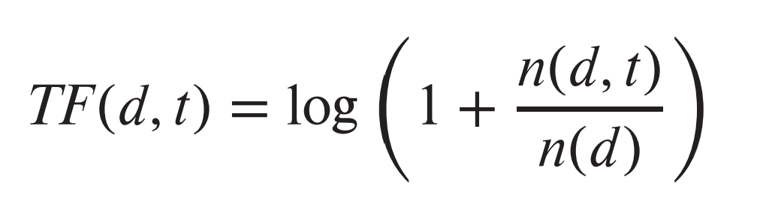
Ranking using TF-IDF
Term: keyword occurring in a document/query
Term Frequency: TF(d, t), the relevance of a term t to a document d
  One definition:
  where
    n(d,t) = number of occurrences of term t in document d
    n(d) = number of terms in document d
    takes the length of the document into account.
    The relevance grows with more occurrences of a term in the document.
Notes:
این فرمول با تقسیم تعداد دفعات ظهور اصطلاح (n(d, t)) بر کل تعداد اصطلاح های سند (n(d)) ، طول سند را در نظر می گیرد. دلیل این امر این است که ظهور مکرر یک ترم در یک سند کوتاه، به اندازه ی ظهور همان ترم چند بار در یک سند بلند، اهمیت ندارد.
لگاریتم موجود در فرمول به این موضوع کمک می کند تا از وزن دهی بسیار زیاد به واژه هایی که خیلی پرتکرار هستند، در مقایسه با واژه های کم تکرار، جلوگیری کند. زیرا لگاریتم با افزایش مقدار، کندتر رشد می کند.
در کل، فرکانس ترم یک مفهوم پایه ای اما مهم در بازیابی اطلاعات است. این به شناسایی کلیدواژه هایی که به احتمال زیاد برای محتوای یک سند مهم هستند، کمک می کند، اما اغلب همراه با تکنیک های دیگری مانند فرکانس معکوس سند (IDF) برای ارائه ارزیابی جامع تری از ارتباط، مورد استفاده قرار می گیرد.
محدودیت شمارش صرف کلیدواژه ها:
مشکل 1: وابستگی به طول سند: صرفا شمارش تعداد تکرار یک اصطلاح، نشانگر خوبی برای ارتباط سند با آن اصطلاح نیست. زیرا تعداد تکرار یک کلمه در اسناد با طول های متفاوت، قابل قیاس نیست.
مشکل 2: وزن دهی نادرست: سندی که حاوی ۱۰ بار تکرار یک اصطلاح باشد، الزاما ۱۰ برابر مرتبط‌تر از سندی با یک بار تکرار آن اصطلاح نیست.
روش های بهبود:
بسیاری از سیستم ها با استفاده از اطلاعات دیگری، معیار شمارش ساده را اصلاح می کنند. به عنوان مثال:
موقعیت کلیدواژه: اگر اصطلاح در عنوان، فهرست نویسنده یا چکیده وجود داشته باشد، ارتباط سند با آن اصطلاح بیشتر در نظر گرفته می شود.
ترتیب اولین کلیدواژه: اگر اولین باری که اصطلاح در سند ظاهر می شود، در ابتدای متن باشد، ارتباط سند با آن اصطلاح بیشتر در نظر گرفته می شود.

Slide 72
Query and Keyword Relevance
Multiple Keywords
  A query Q may contain multiple keywords.
  The relevance of a document to a query with two or more keywords is estimated by combining the relevance measures of the document for each keyword.
Combining Measures
  A simple way of combining the measures is to add them up.
Notes:
یک پرس و جو Q ممکن است حاوی چندین کلمه کلیدی باشد.ارتباط یک سند با یک پرس و جو با دو یا چند کلمه کلیدی با ترکیب معیارهای مربوط بودن سند برای هر کلمه کلیدی تخمین زده می شود.
برای اینکه به هر کلید وزن بدیم و مشکل ارتباط چندکلیدواژه را حل کنیم از IDF یا میزان تکرار سند معکوس استفاده می‌کنیم.

Slide 73
Query and Keyword Relevance
Keyword Frequency
  Not all terms used as keywords are equal.
  Suppose a query uses two terms, one of which occurs frequently, such as “database”, and another that is less frequent, such as “Silberschatz”.
  A document containing “Silberschatz” but not “database” should be ranked higher than a document containing the term “database” but not “Silberschatz”.
Notes:
یک پرس و جو Q ممکن است حاوی چندین کلمه کلیدی باشد.ارتباط یک سند با یک پرس و جو با دو یا چند کلمه کلیدی با ترکیب معیارهای مربوط بودن سند برای هر کلمه کلیدی تخمین زده می شود.
برای اینکه به هر کلید وزن بدیم و مشکل ارتباط چندکلیدواژه را حل کنیم از IDF یا میزان تکرار سند معکوس استفاده می‌کنیم.

Slide 74
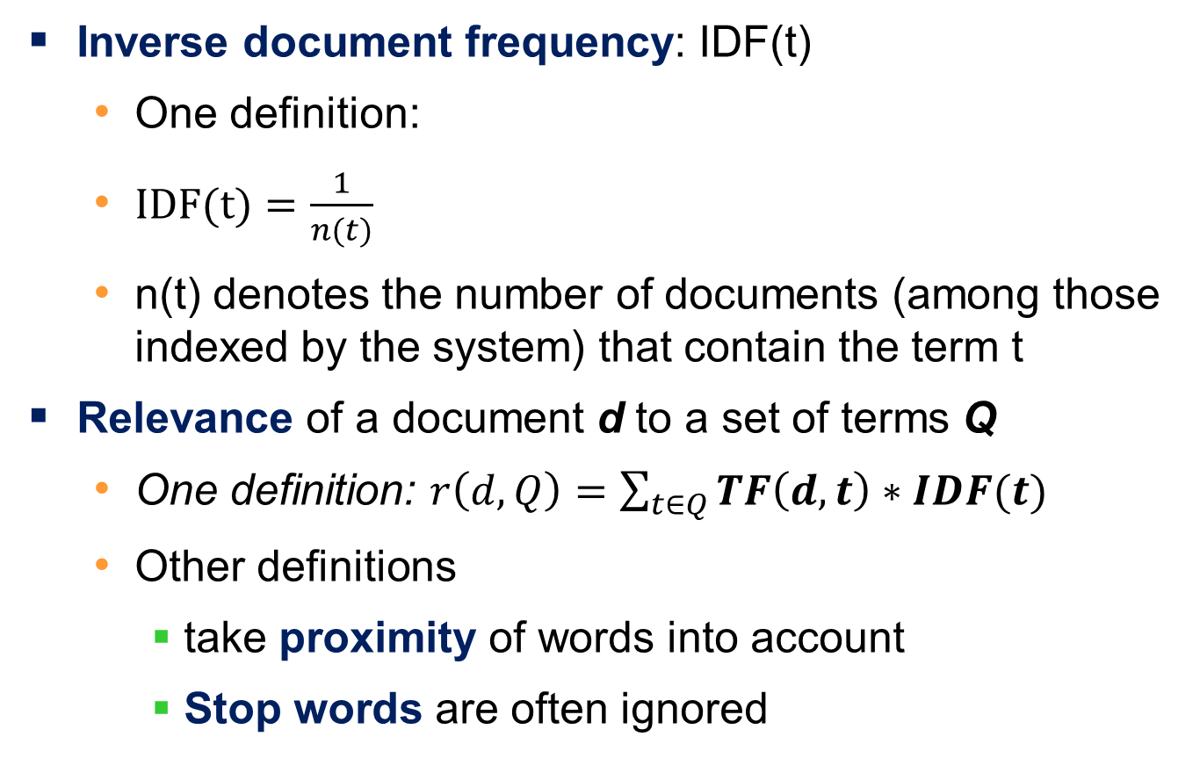
Ranking using TF-IDF
Inverse document frequency: IDF(t)
  One definition:
  $IDF(t)=\frac{1}{n(t)}$
  n(t) denotes the number of documents (among those indexed by the system) that contain the term t
Relevance of a document d to a set of terms Q
  One definition: $r\left(d,Q\right)=\sum_{t∈Q}{TF\left(d,t\right)∗IDF(t)}$
  Other definitions
    take proximity of words into account
    Stop words are often ignored
Notes:
تعریف: IDF(t) = ۱ / n(t) که در آن:
IDF(t): فرکانس معکوس سند برای کلمه کلیدی t.
n(t): تعداد اسناد موجود در مجموعه (فهرست بندی شده توسط سیستم) که حاوی کلمه کلیدی t هستند.
معنی: IDF نشان دهنده میزان کمیابی یک کلمه کلیدی در تمام اسناد است. یک کلمه کلیدی کمیاب، امتیاز IDF بالاتری دارد، که نشان می دهد اطلاعات بیشتری را حمل می کند و ممکن است برای جستجوی خاصی مرتبط تر باشد.
تعریف: r(d, Q) = ∑_(t∈Q) [TF(d,t) * IDF(t)] که در آن:
r(d, Q): امتیاز مرتبط بودن سند d برای مجموعه کلیدواژه های Q را نشان می دهد.
∑_(t∈Q): جمع بندی بر روی همه کلیدواژه ها (t) در مجموعه کلیدواژه ها Q.
TF(d,t): فرکانس کلیدواژه t در سند d (قبلا توضیح داده شد).
IDF(t): فرکانس معکوس سند برای کلمه کلیدی t همانطور که در بالا تعریف شد.
این فرمول فرکانس کلیدواژه (TF) را با فرکانس معکوس سند (IDF) ترکیب می کند تا ارتباط یک سند را با مجموعه ای از کلیدواژه ها تخمین بزند. این فرمول امتیاز بالاتری را به اسنادی اختصاص می دهد که حاوی کلیدواژه های مکرر اما کمیاب در کل مجموعه اسناد هستند.
This measure can be further refined if the user is permitted to specify weights w(t) for terms in the query, in which case the user-specified weights are also taken into account by multiplying TF(t) by w(t) in the preceding formula.

Slide 75
Example for Inverse Document Frequency (IDF)
Imagine a collection with three documents (A, B, C) and two keywords ("mushroom" and "poisonous mushroom"):
* Document A: "Mushrooms are living organisms that..."
* Document B: "There are many types of mushrooms, some edible and others poisonous."
* Document C: "Poisonous mushrooms can be very dangerous."
Calculating IDF:
* Keyword "mushroom": ?
* Keyword "poisonous mushroom": ?
Notes:
As you can see, "poisonous mushroom" is rarer than "mushroom" across the documents, hence its higher IDF. This signifies that the presence of "poisonous mushroom" in a document makes it more relevant to queries related to mushroom poisoning than just "mushroom" alone.

Slide 76
Example for IDF (Cont.)
Calculating IDF:
* Keyword "mushroom":
* Number of documents containing "mushroom" (n(mushroom)) = 3
* IDF(mushroom) = 1 / 3 ≈ 0.33
* Keyword "poisonous mushroom":
* Number of documents containing "poisonous mushroom" (n("poisonous mushroom")) = 2
* IDF("poisonous mushroom") = 1 / 2 ≈ 0.50
Notes:
As you can see, "poisonous mushroom" is rarer than "mushroom" across the documents, hence its higher IDF. This signifies that the presence of "poisonous mushroom" in a document makes it more relevant to queries related to mushroom poisoning than just "mushroom" alone.

Slide 77
Example of document relevance calculation
Scenario:
Imagine a collection with three documents (A, B, C) and two keywords ("music" and "concert"):
Document A: "I enjoy listening to music." (Mentions "music" once)
Document B: "Last weekend, I went to a music concert." (Mentions both "music" and "concert" once)
Document C: "Did you know the speed of sound varies depending on the medium?" (Mentions neither "music" nor "concert")
Notes:
This example demonstrates document relevance calculation (r(d, Q)) with specific, illustrative values for IDF:
1. Document A:
TF(A, "music") = 1: Document A mentions "music" once.
TF(A, "concert") = 0: Document A doesn't mention "concert".
IDF("music") = 0.2 (assumed value): Let's assume "music" is a common term with a lower IDF.
IDF("concert") = 0.8 (assumed value): Let's assume "concert" is a less common term with a higher IDF.
r(A, "music concert") = TF(A, "music") * IDF("music") + TF(A, "concert") * IDF("concert") = 1 * 0.2 + 0 * 0.8 = 0.2

Slide 78
Example of document relevance calculation (Cont.)
Calculating Relevance (r(d, Q)) for the query "music concert":
1. Document A:
TF(A, "music") = 1: Document A mentions "music" once.
TF(A, "concert") = 0: Document A doesn't mention "concert".
IDF("music") = 0.2 (assumed value): Let's assume "music" is a common term with a lower IDF.
IDF("concert") = 0.8 (assumed value): Let's assume "concert" is a less common term with a higher IDF.
r(A, "music concert") = TF(A, "music") * IDF("music") + TF(A, "concert") * IDF("concert") = 1 * 0.2 + 0 * 0.8 = 0.2

Slide 79
Example of document relevance calculation (Cont.)
Calculating Relevance (r(d, Q)) for the query "music concert":
2. Document B:
TF(B, "music") = 1: Document B mentions "music" once.
TF(B, "concert") = 1: Document B mentions "concert" once.
IDF("music") = 0.2 (assumed value): Consistent with Document A.
IDF("concert") = 0.8 (assumed value): Consistent with Document A.
r(B, "music concert") = TF(B, "music") * IDF("music") + TF(B, "concert") * IDF("concert") = 1 * 0.2 + 1 * 0.8 = 1.0

Slide 80
Example of document relevance calculation (Cont.)
3. Document C:
TF(C, "music") = 0: Document C doesn't mention "music".
TF(C, "concert") = 0: Document C doesn't mention "concert".
IDF("music") = 0.2 (assumed value): Consistent with Documents A and B.
IDF("concert") = 0.8 (assumed value): Consistent with Documents A and B.
r(C, "music concert") = TF(C, "music") * IDF("music") + TF(C, "concert") * IDF("concert") = 0 * 0.2 + 0 * 0.8 = 0
Notes:
Interpretation:
Document A mentions only "music" and receives a low score (0.2) due to the lower IDF value of "music".
Document B mentions both "music" and "concert" and receives the highest score (1.0) because it includes both query terms and benefits from the higher IDF value of "concert".
Document C mentions neither term and receives a score of 0, reflecting its lack of relevance to the query.
Note: This example uses specific, illustrative values for IDF for demonstration purposes. Actual IDF values in real-world information retrieval systems are calculated based on the specific document collection and would likely differ.

Slide 81
Stop Words in Information Retrieval
  Information-retrieval systems define a set of words, called stop words, containing 100 or so of the most common words, and ignore these words when indexing a document.
    Such words are not used as keywords, and they are discarded if present in the keywords supplied by the user.
      and,” “or,” “a,” and so on.
    Including them in the indexing process and user queries can increase processing time and potentially distract the system from identifying more informative keywords.
Notes:
تکرار معکوس سند- inverse document frequency
For example, if a user searches for "buy books online," including stop words like "the" and "on" wouldn't significantly impact finding relevant results.
3. How are Stop Words Handled?
Information retrieval systems typically remove stop words during the indexing process. This means they are not stored as keywords associated with a document.
When a user submits a query, the system might also remove stop words before searching for relevant documents. This ensures the search focuses on the meaningful keywords rather than common words with limited information value.
While stop words are generally ignored, there are certain exceptions where they might be considered. For example, search engines might treat stop words differently when handling phrase searches.

Slide 82
Proximity of Terms
Proximity of Terms
  Another factor taken into account when a query contains multiple terms is the proximity of the terms in the document.
  If the terms occur close to each other in the document, the document will be ranked higher than if they occur far apart.
  The formula for r(d, Q) can be modified to take proximity of the terms into account.
Notes:
Returning Documents
Given a query Q, the job of an information-retrieval system is to return documents in descending order of their relevance to Q.
a very large number of documents are relevant, information-retrieval systems typically return only the first few documents with the highest degree of estimated relevance and permit users to interactively request further documents

Slide 83
Ranking Using Hyperlinks
Hyperlinks provide very important clues to importance
Google introduced PageRank, a measure of popularity/importance based on hyperlinks to pages
  Pages hyperlinked from many pages should have higher PageRank
  Pages hyperlinked from pages with higher PageRank should have higher PageRank
    Formalized by random walk model
Notes:
هایپرلینک‌ها به عنوان سرنخ‌هایی برای اهمیت:
این متن بر اهمیت ابرلینک‌ها (همچنین به عنوان بک‌لینک‌ها شناخته می‌شوند) در تعیین اهمیت نسبی صفحات وب تاکید می‌کند. زمانی که یک صفحه وب به صفحه دیگری لینک می‌دهد، این کار به عنوان رأی اعتماد به صفحه لینک‌داده‌شده در نظر گرفته می‌شود.
صفحه‌رتبه: اندازه‌گیری محبوبیت/اهمیت:
گوگل صفحه‌رتبه را به عنوان روشی برای کمی‌سازی این سیستم «رأی‌دهی» و تخمین محبوبیت یا اهمیت یک صفحه وب معرفی کرد. ایده اصلی این است که صفحاتی که لینک‌های ورودی بیشتری از صفحات مهم دارند، به طور کلی خودشان مهم‌تر در نظر گرفته می‌شوند.
1. Hyperlinks as Clues to Importance:
The text emphasizes the importance of hyperlinks (also known as backlinks) in determining the relative importance of web pages.
When one web page links to another, it's considered a vote of confidence for the linked page.
2. PageRank: Measuring Popularity/Importance:
Google introduced PageRank as a method to quantify this "voting" system and estimate the popularity or importance of a web page.
The core idea is that pages with more incoming links from important pages are generally considered more important themselves.
3. How PageRank Works:
The text mentions two key principles:
Pages with many backlinks (hyperlinks from other pages) receive a higher PageRank score.
The importance of the linking page also matters. Links from pages with higher PageRank contribute more significantly to the linked page's score.
4. Formalized by Random Walk Model:
PageRank is formally defined using a mathematical model called the random surfer model.
This model simulates a hypothetical "random surfer" who randomly clicks on links on a web page and then continues clicking on links on the new page, and so on.
The probability of the surfer landing on a particular page is influenced by the PageRank scores of the pages and the links between them.

Slide 84
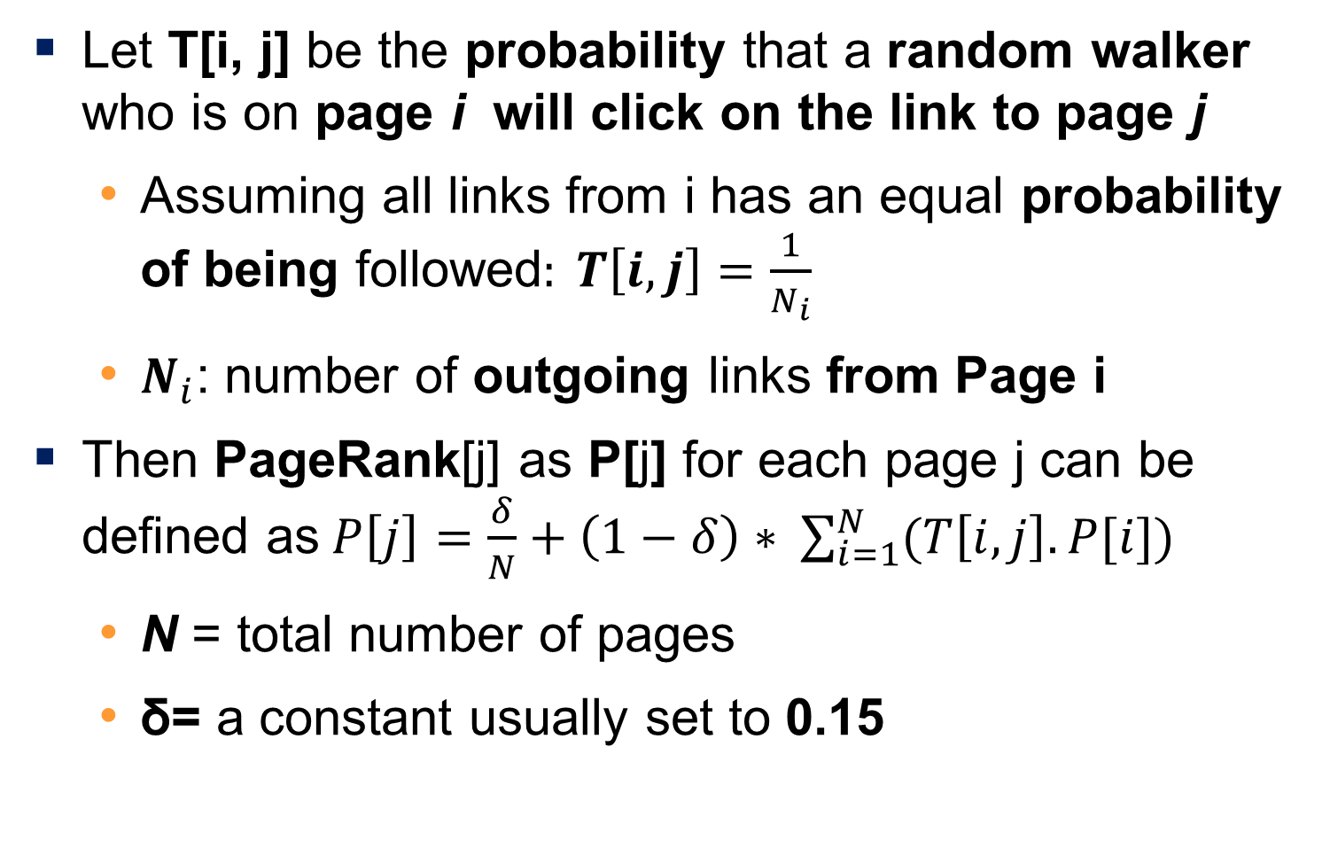
Ranking Using Hyperlinks
Let T[i, j] be the probability that a random walker who is on page i will click on the link to page j
  Assuming all links from i has an equal probability of being followed$: T\left[i,j\right]=\frac{1}{N_{i}}$
  $N_{i}$: number of outgoing links from Page i
Then PageRank[j] as P[j] for each page j can be defined as$P\left[j\right]=\frac{δ}{N}+\left(1−δ\right)∗ \sum_{i=1}^{N}{(T\left[i,j\right].P[i])}$
  N = total number of pages
  δ= a constant usually set to 0.15
Notes:
A page's PageRank score reflects the likelihood of a random walker landing on that page after following a sequence of links, considering the importance of the pages it links from.
δ delta
رتبه‌ی صفحه (PageRank) تنها معیار محبوبیت یک سایت نیست. تعداد دفعات بازدید کاربران از یک سایت، نشانگر دیگری از محبوبیت آن است. همچنین، موتورهای جستجو زمانی که سایتی را به‌عنوان پاسخ نمایش می‌دهند، ردیابی می‌کنند که کاربران چند بار روی آن سایت کلیک می‌کنند.
کلمات کلیدی که در متن لنگر (anchor text) مرتبط با پیوند به یک صفحه ظاهر می‌شوند، بسیار مهم تلقی شده و دارای بسامدTR بالاتری در نظر گرفته می‌شوند. این موارد و تعدادی از عوامل دیگر برای رتبه‌بندی پاسخ‌ها به یک عبارت کلیدی در موتورهای جستجو مورد استفاده قرار می‌گیرند.

Slide 85
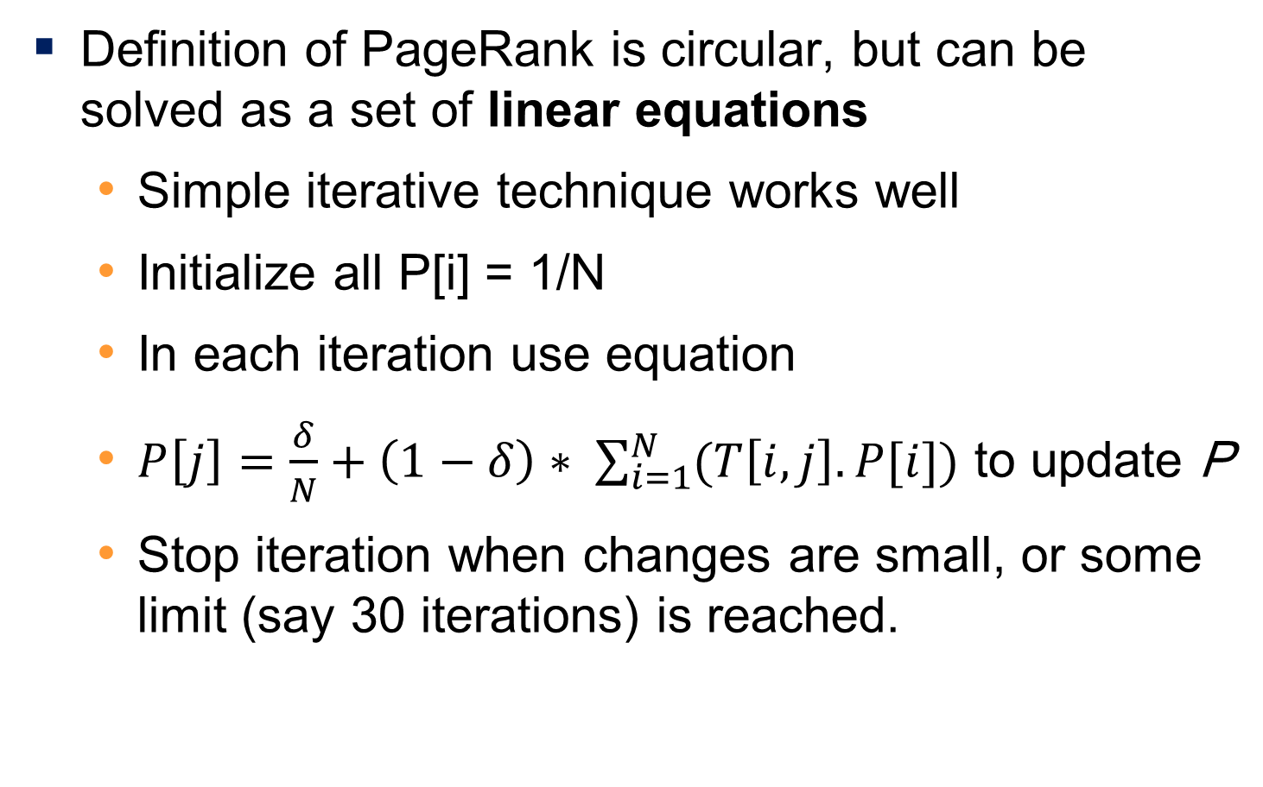
Ranking Using Hyperlinks
Definition of PageRank is circular, but can be solved as a set of linear equations
  Simple iterative technique works well
  Initialize all P[i] = 1/N
  In each iteration use equation
  $P\left[j\right]=\frac{δ}{N}+\left(1−δ\right)∗ \sum_{i=1}^{N}{(T\left[i,j\right].P[i])}$ to update P
  Stop iteration when changes are small, or some limit (say 30 iterations) is reached.
Notes:
Iterative Technique and PageRank
Iterative Technique
The set of equations generated are usually solved by an iterative technique.
Start with each P[i] set to 1/N.
Each step of the iteration computes new values for each P[i] using the P values from the previous iteration.
Iteration stops when the maximum change in any P[i] value in an iteration goes below some cutoff value.
PageRank
PageRank is a static measure, independent of the keyword query.
Given a keyword query, it is used in combination with TF–IDF scores of a document to judge its relevance to the keyword query.
Popularity Measures
PageRank is not the only measure of the popularity of a site.
Information about how often a site is visited is another useful measure of popularity.
Search engines track what fraction of times users click on a page when it is returned as an answer.
Keyword Importance
Keywords that occur in the anchor text associated with the hyperlink to a page are viewed as very important and are given a higher term frequency.
These and a number of other factors are used to rank answers to a keyword query.

Slide 86
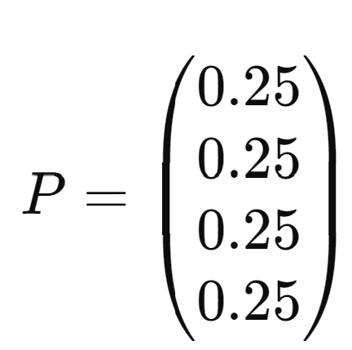
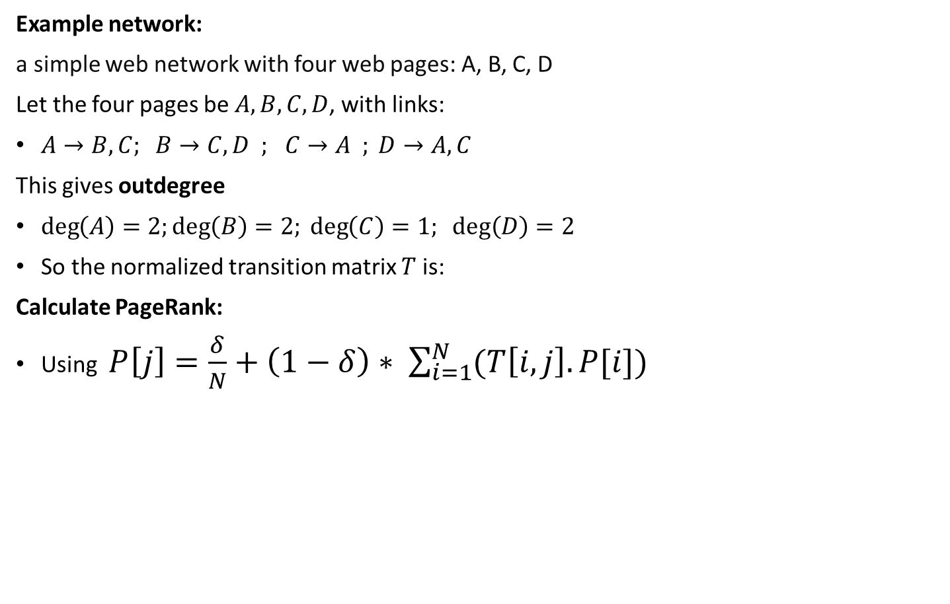
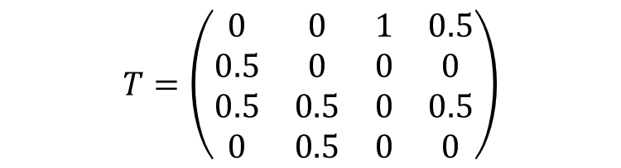
Example
Example network:
a simple web network with four web pages: A, B, C, D
Let the four pages be $A,B,C,D$, with links:
$A→B,C; B→C,D ;$ $C→A ; D→A,C$
This gives outdegree
$\deg\left(A\right)=2;\deg\left(B\right)=2; \deg\left(C\right)=1; deg⁡\left(D\right)=2$
So the normalized transition matrix $T$ is:
Calculate PageRank:
Using $P\left[j\right]=\frac{δ}{N}+\left(1−δ\right)∗ \sum_{i=1}^{N}{(T\left[i,j\right].P[i])}$
$$T=\left(\begin{matrix}0 & 0 & 1 & 0.5 \\ 0.5 & 0 & 0 & 0 \\ 0.5 & 0.5 & 0 & 0.5 \\ 0 & 0.5 & 0 & 0\end{matrix}\right)$$
Notes:
Let's calculate \( P[j] \) for each page:
1. For Page A:
\[ P[A] = \frac{0.85}{4} + (1 - 0.85) \times [(0 \times 0.25) + (0.5 \times 0.25) + (0.5 \times 0.25) + (0 \times 0.25)] \]
\[ P[A] = 0.2125 + 0.1275 = 0.34 \]
2. For Page B:
P[D]=0.375​+(0.85)×[(0×0.25)+(0.5×0.25)+(1×0.25)+(0×0.25)]
\[ P[B] = \frac{0.85}{4} + (1 - 0.85) \times [(0.5 \times 0.25) + (0 \times 0.25) + (0.5 \times 0.25) + (0 \times 0.25)] \]
P[B] = 0.2125 + 0.1275 = 0.34 \]
3. For Page C:
\[ P[C] = \frac{0.85}{4} + (1 - 0.85) \times [(0.5 \times 0.25) + (0.5 \times 0.25) + (0 \times 0.25) + (1 \times 0.25)] \]
\[ P[C] = 0.2125 + 0.44625 = 0.65875 \]
4. For Page D:
\[ P[D] = \frac{0.85}{4} + (1 - 0.85) \times [(0 \times 0.25) + (0 \times 0.25) + (1 \times 0.25) + (0 \times 0.25)] \]
\[ P[D] = 0.2125 + 0.0425 = 0.255 \]
So, after one iteration of the PageRank algorithm, the PageRank scores are approximately:
\[ P = \begin{pmatrix} 0.34 \\ 0.34 \\ 0.66 \\ 0.26 \end{pmatrix} \]
These scores represent the importance of each page in the network.

Slide 87
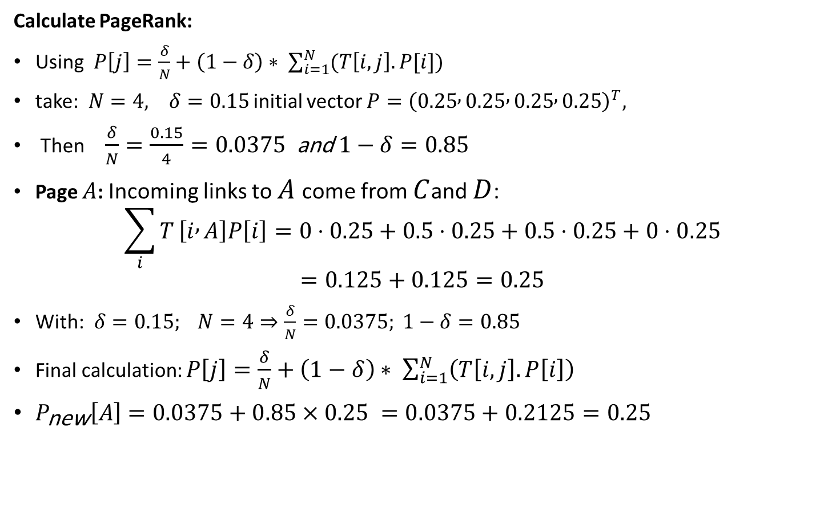

Example
Calculate PageRank:
Using $P\left[j\right]=\frac{δ}{N}+\left(1−δ\right)∗ \sum_{i=1}^{N}{(T\left[i,j\right].P[i])}$
take:$N=4, δ=0.15$ initial vector $P={\left(0.25 , 0.25 , 0.25 , 0.25\right)}^{T},$
Then$\frac{δ}{N}=\frac{0.15}{4}=0.0375 \text{and} 1−δ=0.85$
Page $A$: Incoming links to $A$come from $C$and $D$:
$$\sum_{i}{T}\left[i , A\right]P\left[i\right]=0⋅0.25+0.5⋅0.25+0.5⋅0.25+0⋅0.25$$
$$=0.125+0.125=0.25$$
With:$δ=0.15; N=4⇒\frac{δ}{N}=0.0375; 1−δ=0.85$
Final calculation: $P\left[j\right]=\frac{δ}{N}+\left(1−δ\right)∗ \sum_{i=1}^{N}{\left(T\left[i,j\right].P\left[i\right]\right)}$
$P_{\text{new}}\left[A\right]=0.0375+0.85×0.25 =0.0375+0.2125=0.25$
$$T=\left(\begin{matrix}0 & 0 & 1 & 0.5 \\ 0.5 & 0 & 0 & 0 \\ 0.5 & 0.5 & 0 & 0.5 \\ 0 & 0.5 & 0 & 0\end{matrix}\right)$$
Notes:
Let's calculate \( P[j] \) for each page:
1. For Page A:
\[ P[A] = \frac{0.85}{4} + (1 - 0.85) \times [(0 \times 0.25) + (0.5 \times 0.25) + (0.5 \times 0.25) + (0 \times 0.25)] \]
\[ P[A] = 0.2125 + 0.1275 = 0.34 \]
2. For Page B:
P[D]=0.375​+(0.85)×[(0×0.25)+(0.5×0.25)+(1×0.25)+(0×0.25)]
\[ P[B] = \frac{0.85}{4} + (1 - 0.85) \times [(0.5 \times 0.25) + (0 \times 0.25) + (0.5 \times 0.25) + (0 \times 0.25)] \]
P[B] = 0.2125 + 0.1275 = 0.34 \]
3. For Page C:
\[ P[C] = \frac{0.85}{4} + (1 - 0.85) \times [(0.5 \times 0.25) + (0.5 \times 0.25) + (0 \times 0.25) + (1 \times 0.25)] \]
\[ P[C] = 0.2125 + 0.44625 = 0.65875 \]
4. For Page D:
\[ P[D] = \frac{0.85}{4} + (1 - 0.85) \times [(0 \times 0.25) + (0 \times 0.25) + (1 \times 0.25) + (0 \times 0.25)] \]
\[ P[D] = 0.2125 + 0.0425 = 0.255 \]
So, after one iteration of the PageRank algorithm, the PageRank scores are approximately:
\[ P = \begin{pmatrix} 0.34 \\ 0.34 \\ 0.66 \\ 0.26 \end{pmatrix} \]
These scores represent the importance of each page in the network.

Slide 88
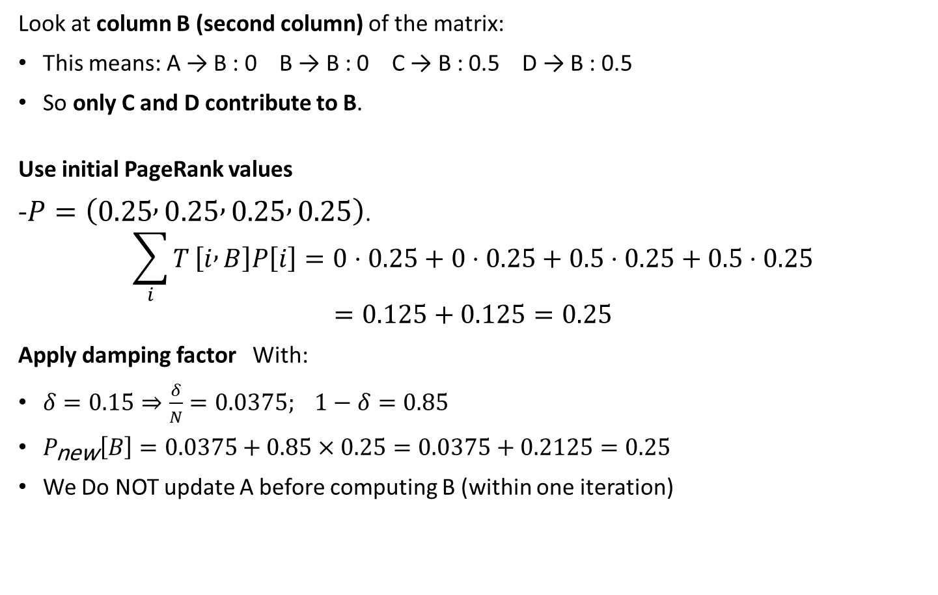
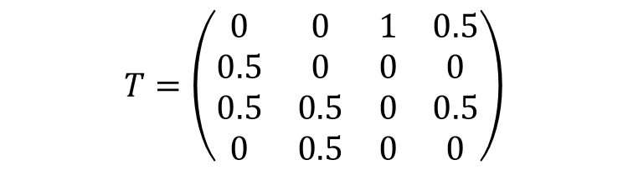
Example
Look at column B (second column) of the matrix:
This means: A → B : 0 B → B : 0 C → B : 0.5 D → B : 0.5
So only C and D contribute to B.
Use initial PageRank values
-$P=\left(0.25 , 0.25 , 0.25 , 0.25\right)$.
$$\sum_{i}{T}\left[i , B\right]P\left[i\right]=0⋅0.25+0⋅0.25+0.5⋅0.25+0.5⋅0.25$$
$$=0.125+0.125=0.25$$
Apply damping factor With:
$δ=0.15⇒\frac{δ}{N}=0.0375; 1−δ=0.85$
$P_{\text{new}}\left[B\right]=0.0375+0.85×0.25=0.0375+0.2125=0.25$
We Do NOT update A before computing B (within one iteration)
$$T=\left(\begin{matrix}0 & 0 & 1 & 0.5 \\ 0.5 & 0 & 0 & 0 \\ 0.5 & 0.5 & 0 & 0.5 \\ 0 & 0.5 & 0 & 0\end{matrix}\right)$$
Notes:
❌ Do NOT update A before computing B (within one iteration) ✅ Use the original vector for all nodes

Slide 89
Retrieval Effectiveness
Measures of effectiveness
  Precision: what percentage of returned results are relevant
  Recall: what percentage of relevant results were returned
    since search engines find a very large number of answers, precision and recall numbers are usually measured by “@K”, where K is the number of answers viewed
Notes:
رتبه بندی نتایج حاصل از یک جستجوی کلیدواژه، یک علم دقیق نیست. از دو معیار برای سنجش میزان کارایی یک سیستم بازیابی اطلاعات در پاسخ به پرس و جوها استفاده می شود.
دقت، سنجش می کند که چه درصدی از اسناد بازیابی شده، واقعا مرتبط با پرس و جو هستند.
فراخوانی، سنجش می کند که چه درصدی از اسناد مرتبط با پرس و جو، بازیابی شده اند.
موتورهای جستجو تعداد بسیار زیادی از نتایج را پیدا می‌کنند، اما کاربران معمولا بعد از مرور تعدادی از آن‌ها (مثلا ۱۰ یا ۲۰ نتیجه) دست می‌کشند. به همین دلیل، دقت (precision) و فراخوان (recall) معمولا با "@K" سنجیده می‌شوند که در آن K تعداد نتایج مشاهده شده است. بنابراین، می‌توان از دقت@۱۰ یا فراخوان@۲۰ صحبت کرد.

Slide 90
Spatial Data
Notes:
spatial ['speɪʃl]

Slide 91
Spatial Data
Spatial databases store information related to spatial locations, and support efficient storage, indexing and querying of spatial data.
  Geographic data -- road maps, land-usage maps, topographic elevation maps, political maps showing boundaries, land-ownership maps, and so on.
    Geographic information systems are special-purpose databases tailored for storing geographic data.
    Round-earth coordinate system may be used
      (Latitude, longitude, elevation)
  Geometric data: design information about how objects are constructed . For example, designs of buildings, aircraft, layouts of integrated-circuits.
    2 or 3 dimensional Euclidean space with (X, Y, Z) coordinates
Notes:
پایگاه داده‌های مکانی مزایای قابل توجهی را ارائه می‌دهند و امکان موارد زیر را فراهم می‌کنند:
ذخیره‌سازی کارآمد: پایگاه داده‌های مکانی از ساختارهای داده تخصصی برای بهینه‌سازی ذخیره‌سازی و بازیابی داده‌های مکانی که می‌توانند پیچیده و چندبعدی باشند، استفاده می‌کنند.
ایجاد فهرست کارآمد: مشابه با پایگاه داده‌های سنتی، پایگاه داده‌های مکانی از تکنیک‌های فهرست‌بندی مکانی برای تسهیل بازیابی سریع‌تر داده‌ها بر اساس پرس و جوهای خاص مکان استفاده می‌کنند. این امر امکان جستجو و فیلتر کردن کارآمد بر اساس معیارهای جغرافیایی را فراهم می‌کند.
پرس و جوی قدرتمند: پایگاه داده‌های مکانی از قابلیت‌های پرس و جوی پیشرفته‌ای فراتر از جستجوی ساده کلیدواژه پشتیبانی می‌کند. کاربران می‌توانند بر اساس روابط مکانی، پرس و جوهای پیچیده‌ای را انجام دهند، مانند یافتن مکان‌هایی در شعاع معین، شناسایی نقاط مورد علاقه در نزدیکی یا تجزیه و تحلیل الگوهای فضایی.
نمونه‌هایی از داده‌های مکانی:
داده‌های جغرافیایی: این شامل انواع مختلف نقشه‌ها مانند نقشه‌های جاده‌ای، نقشه‌های کاربری اراضی، نقشه‌های ارتفاع توپوگرافی، نقشه‌های سیاسی با مرزها و نقشه‌های مالکیت زمین می‌شود.
سیستم‌های اطلاعات جغرافیایی (GIS): این سیستم‌ها نرم‌افزارهای تخصصی هستند که برای ثبت، تجزیه و تحلیل و نمایش داده‌های جغرافیایی طراحی شده‌اند. آنها اغلب برای مدیریت و ذخیره اطلاعات جغرافیایی اساسی خود به پایگاه داده‌های مکانی متکی هستند.
سیستم‌های مختصات: داده‌های مکانی را می‌توان با استفاده از سیستم‌های مختصات مختلف نمایش داد، مانند سیستم مختصات زمین گرد که از عرض جغرافیایی، طول جغرافیایی و ارتفاع برای مشخص کردن مکان‌ها روی سطح زمین استفاده می‌کند.
داده‌های هندسی: این نوع داده شامل اطلاعات طراحی در مورد شکل‌ها و روابط فضایی اشیاء می‌شود و اغلب در زمینه‌هایی

Slide 92
Represented of Geometric Information
Various geometric constructs can be represented in a database in a normalized fashion (see next slide)
A line segment can be represented by the coordinates of its endpoints.
A polyline or linestring consists of a connected sequence of line segments and can be represented by a list containing the coordinates of the endpoints of the segments, in sequence.
Polygons are represented by a list of vertices in order.
  The list of vertices specifies the boundary of a polygonal region.
  Can also be represented as a set of triangles (triangulation)
Notes:
نمایش ساختارهای هندسی در پایگاه داده
ساختارهای مختلف هندسی را می توان به صورت نرمال (در اسلاید بعدی توضیح داده می شود) در یک پایگاه داده نمایش داد.
پاره خط: با مختصات نقاط انتهایی آن قابل نمایش است.
خط شکسته (یا رشته خطی) متشکل از یک توالی متصل از پاره خطوط است و می توان آن را با فهرستی شامل مختصات نقاط انتهایی بخش ها به ترتیب نمایش داد.
چندضلعی: با لیستی از رأس ها به ترتیب مشخص می شود.
لیست رأس ها، مرز یک ناحیه چندضلعی را مشخص می کند.
همچنین می تواند به عنوان مجموعه ای از مثلث ها (مثلث‌بندی) نمایش داده شود.

Slide 93
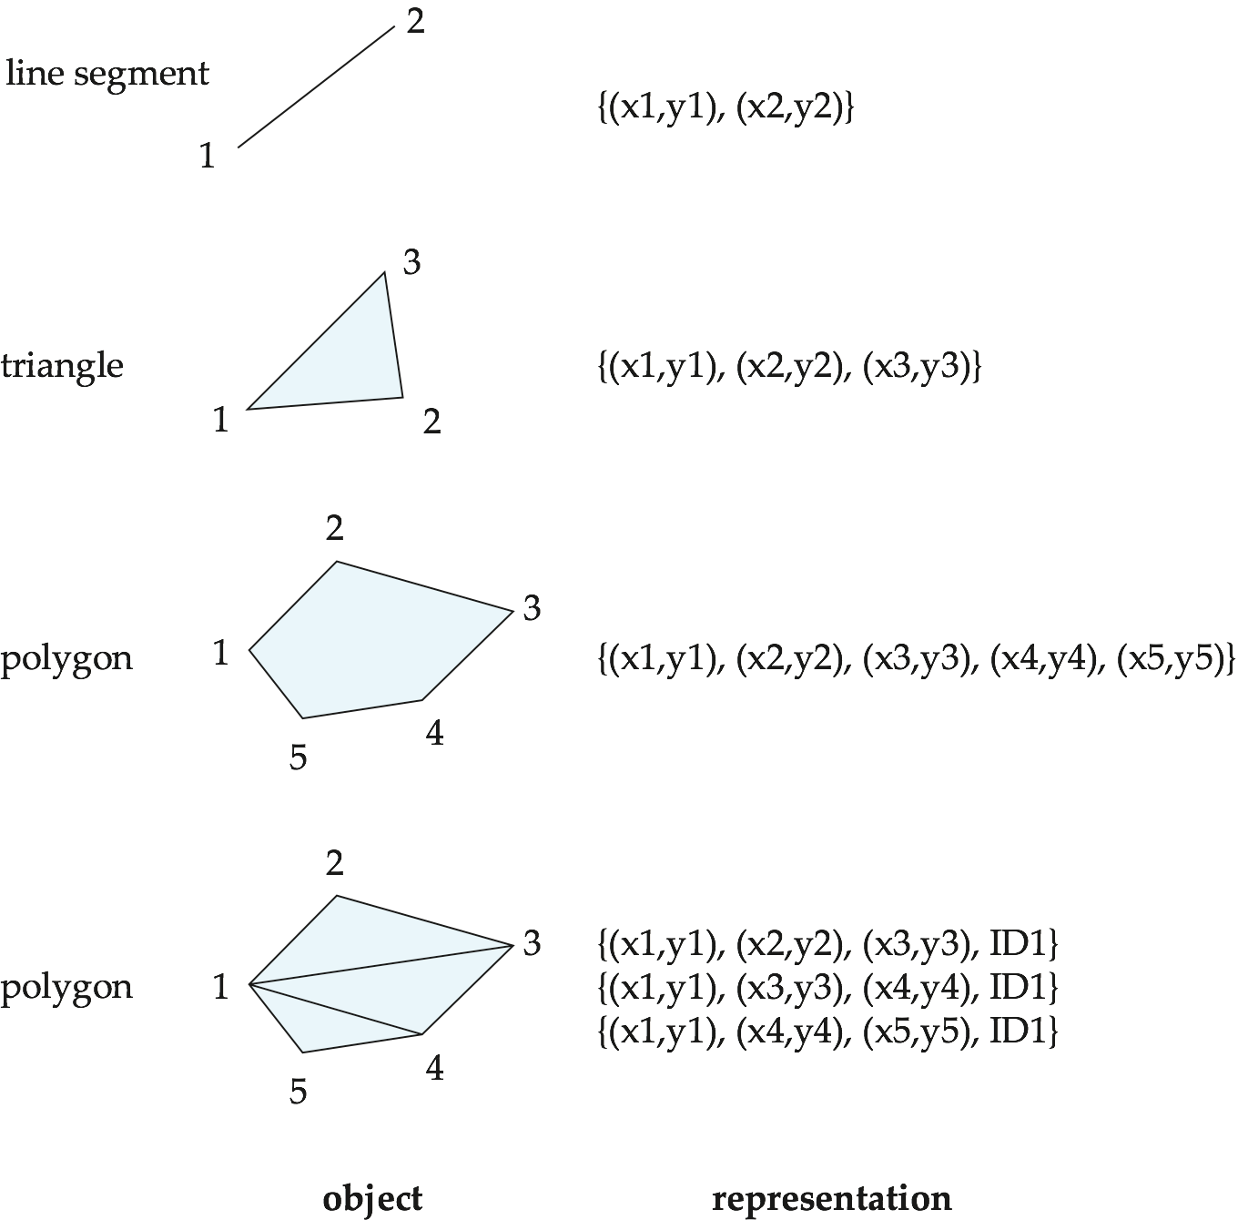
Representation of Geometric Constructs

Slide 94
For example
SQL Server and PostGIS support the geometry and geography types
  subtypes such as point, linestring, curve, polygon, as collections of these types called multipoint, multilinestring, multicurve and multipolygon.
Textual representations of these types are defined by the OGC standards, and can be converted to internal representations using conversion functions.
  For example,
    LINESTRING(1 1, 2 3, 4 4) defines a line that connects points (1, 1), (2, 3) and (4, 4),
    POLYGON((1 1, 2 3, 4 4, 1 1)) defines a triangle defined by these points.
Notes:
SQL Server و PostGIS از انواع هندسه (geometry) و جغرافیا (geography) پشتیبانی می‌کنند که شامل زیرمجموعه‌هایی مانند نقطه (point)، خط (linestring)، منحنی (curve)، چندضلعی (polygon) و مجموعه‌هایی از این انواع به نام چندنقطه (multipoint)، چندخط (multilinestring)، چندمنحنی (multicurve) و چندضلعی (multipolygon) می‌شوند.
نمایش متنی این انواع توسط استانداردهای OGC تعریف شده است و با استفاده از توابع تبدیل، می‌توان آن‌ها را به نمایش‌های داخلی تبدیل کرد.
برای مثال، عبارت LINESTRING(1 1, 2 3, 4 4) خطی را تعریف می‌کند که نقاط (1, 1)، (2, 3) و (4, 4) را به هم وصل می‌کند.
همچنین، عبارت POLYGON((1 1, 2 3, 4 4, 1 1)) یک مثلث را که توسط این نقاط تعریف می‌شود، نمایش می‌دهد.

Slide 95
To Design Databases
Represent design components as objects (generally geometric objects); the connections between the objects indicate how the design is structured.
Simple two-dimensional objects: points, lines, triangles, rectangles, polygons.
Complex two-dimensional objects: formed from simple objects via union, intersection, and difference operations.
Complex three-dimensional objects: formed from simpler objects such as spheres, cylinders, and cuboids, by union, intersection, and difference operations.
Notes:
نمایش اجزای طراحی با استفاده از اشیاء هندسی
در بسیاری از رویکردهای طراحی، اجزای مختلف طراحی با استفاده از اشیاء (معمولا اشیاء هندسی) نمایش داده می شوند. ارتباطات بین این اشیاء ساختار کلی طراحی را مشخص می کند.
انواع اشیاء مورد استفاده در طراحی:
اشیاء ساده دو بعدی: شامل نقطه، خط، مثلث، مستطیل و چندضلعی می شوند.
اشیاء پیچیده دو بعدی: از ترکیب اشیاء ساده و با استفاده از عملیات اتحاد، اشتراک و تفاضل ایجاد می شوند.
اشیاء پیچیده سه بعدی: از ترکیب اشیاء ساده تر مانند کره، استوانه و مکعب مستطیل با استفاده از عملیات اتحاد، اشتراک و تفاضل ساخته می شوند.

Slide 96
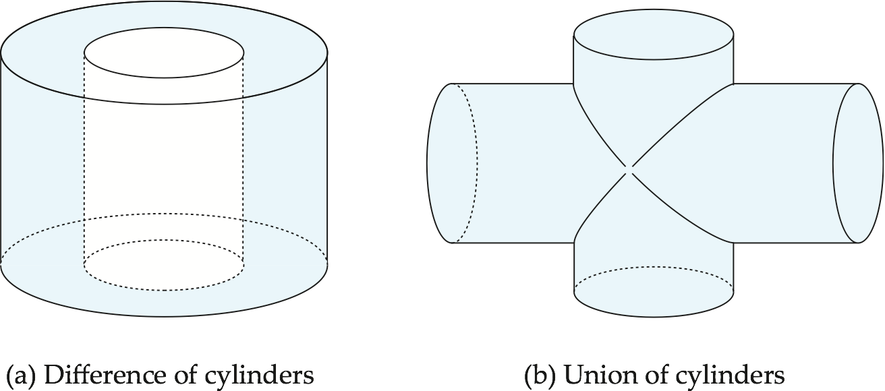
Representation of Geometric Constructs
Design databases also store non-spatial information about objects (e.g., construction material, color, etc.)
Spatial integrity constraints are important.
  E.g., pipes should not intersect, wires should not be too close to each other, etc.
Notes:
Various spatial operations must be performed on a design. For instance, the designer may want to retrieve that part of the design that corresponds to a particular region of interest.
Open-Source Geospatial Databases:
PostGIS: This is a widely used open-source extension for PostgreSQL that adds spatial functionality to a traditional relational database. It's a popular choice due to its cost-effectiveness, good performance, and large developer community.
SpatiaLite: This is a lightweight spatial database engine built on top of the SQLite library. It's a good option for mobile apps or situations where a small footprint and offline functionality are crucial.

Slide 97
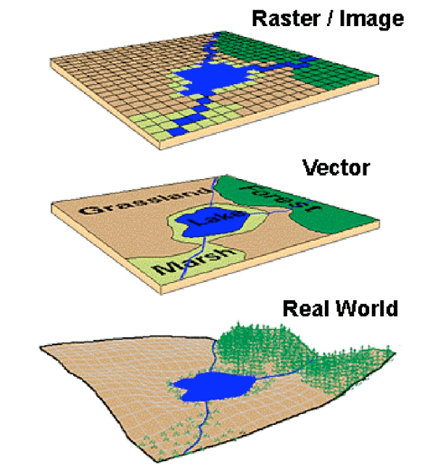
Geographic Data
Raster data consist of bit maps or pixel maps, in two or more dimensions.
  Example 2-D raster image: satellite image of cloud cover, where each pixel stores the cloud visibility in a particular area.
  Additional dimensions might include the temperature at different altitudes at different regions, or measurements taken at different points in time.
Design databases generally do not store raster data.
Notes:
داده‌های تصویری یا رستری: هرگونه داده‌ی پیکسل‌بندی‌شده (یا شبکه‌ای) است که در آن هر پیکسل با یک موقعیت جغرافیایی خاص مرتبط است.
داده‌های رستری: پیکسل به پیکسل
داده‌های رستری از نقشه بیت یا نقشه پیکسلی در دو بعد یا بیشتر تشکیل شده‌اند.
مثال تصویر رستری دو بعدی: تصویر ماهواره‌ای از پوشش ابر، که در آن هر پیکسل، میزان قابل رؤیت بودن ابرها را در یک ناحیه خاص ذخیره می‌کند.
ابعاد اضافی ممکن است شامل دما در ارتفاعات مختلف در مناطق مختلف یا اندازه‌گیری‌های گرفته شده در نقاط مختلف زمان باشد.
پایگاه داده‌های طراحی به طور کلی داده‌های رستری را ذخیره نمی‌کنند.

Slide 98
Geographic Data (Cont.)
Vector data are constructed from basic geometric objects: points, line segments, triangles, and other polygons in two dimensions, and cylinders, spheres, cuboids, and other polyhedrons in three dimensions.
Vector format often used to represent map data.
  Roads can be considered as two-dimensional and represented by lines and curves.
  Some features, such as rivers, may be represented either as complex curves or as complex polygons, depending on whether their width is relevant.
  Features such as regions and lakes can be depicted as polygons.
Notes:
داده‌های برداری: ساختار و کاربرد در نقشه‌ها
داده‌های برداری از اشیاء هندسی اولیه ساخته می‌شوند: نقطه، پاره خط، مثلث، چندضلعی در دو بعد و استوانه، کره، مکعب مستطیل و سایر چندوجهی‌ها در سه بعد.
این نوع از داده‌ها اغلب برای نمایش اطلاعات نقشه استفاده می‌شوند.
راه‌ها: می‌توانند به عنوان دو بعدی در نظر گرفته شوند و با خط و منحنی نشان داده شوند.
برخی از عوارض مانند رودخانه‌ها، بسته به اینکه عرض آن‌ها مهم باشد، ممکن است به صورت منحنی‌های پیچیده یا چندضلعی‌های پیچیده نشان داده شوند.
عوارض مانند مناطق و دریاچه‌ها می‌توانند به صورت چندضلعی ترسیم شوند.

Slide 99
Spatial Queries
Region queries deal with spatial regions. e.g., ask for objects that lie partially or fully inside a specified region
  E.g., PostGIS ST_Contains(), ST_Overlaps(), …
Nearness queries request objects that lie near a specified location.
Nearest neighbor queries, given a point or an object, find the nearest object that satisfies given conditions.
Spatial graph queries request information based on spatial graphs
  E.g., shortest path between two points via a road network
Spatial join of two spatial relations with the location playing the role of join attribute.
  Queries that compute intersections or unions of regions
Notes:
پرس و جوهای فضایی در پایگاه داده‌های مکانی
پرس و جوهای فضایی نوع خاصی از پرس و جوها هستند که با داده‌های مکانی مرتبط با موقعیت سر و کار دارند.
در اینجا چند نوع رایج از پرس و جوهای فضایی آورده شده است:
پرس و جوهای منطقه‌ای: با نواحی فضایی سروکار دارند. به عنوان مثال، درخواست اشیایی که به طور کامل یا جزئی داخل یک منطقه مشخص قرار دارند.
نمونه‌هایی از توابع مورد استفاده در PostGIS: ST_Contains()، ST_Overlaps() و …
پرس و جوهای نزدیکی: درخواست اشیایی که در نزدیکی یک مکان خاص قرار دارند.
پرس و جوهای نزدیک‌ترین همسایه: با در نظر گرفتن یک نقطه یا شیء، نزدیک‌ترین شیئی را که شرایط خاصی را برآورده می‌کند، پیدا کنید.
پرس و جوهای گراف فضایی: اطلاعاتی را بر اساس گراف‌های فضایی درخواست می‌کنند.
به عنوان مثال، کوتاه‌ترین مسیر بین دو نقطه از طریق یک شبکه جاده‌ای
الحاق فضایی: الحاق دو رابطه فضایی با موقعیت به عنوان صفت الحاق.
پرس و جوهایی که تقاطع یا اتحادیه مناطق را محاسبه می‌کنند: این پرس و جوها با استفاده از عملیات‌های مجموعه نظریه بر روی مناطق فضایی عمل می‌کنند.

Slide 100
End of Lecture 1

